Slide 1
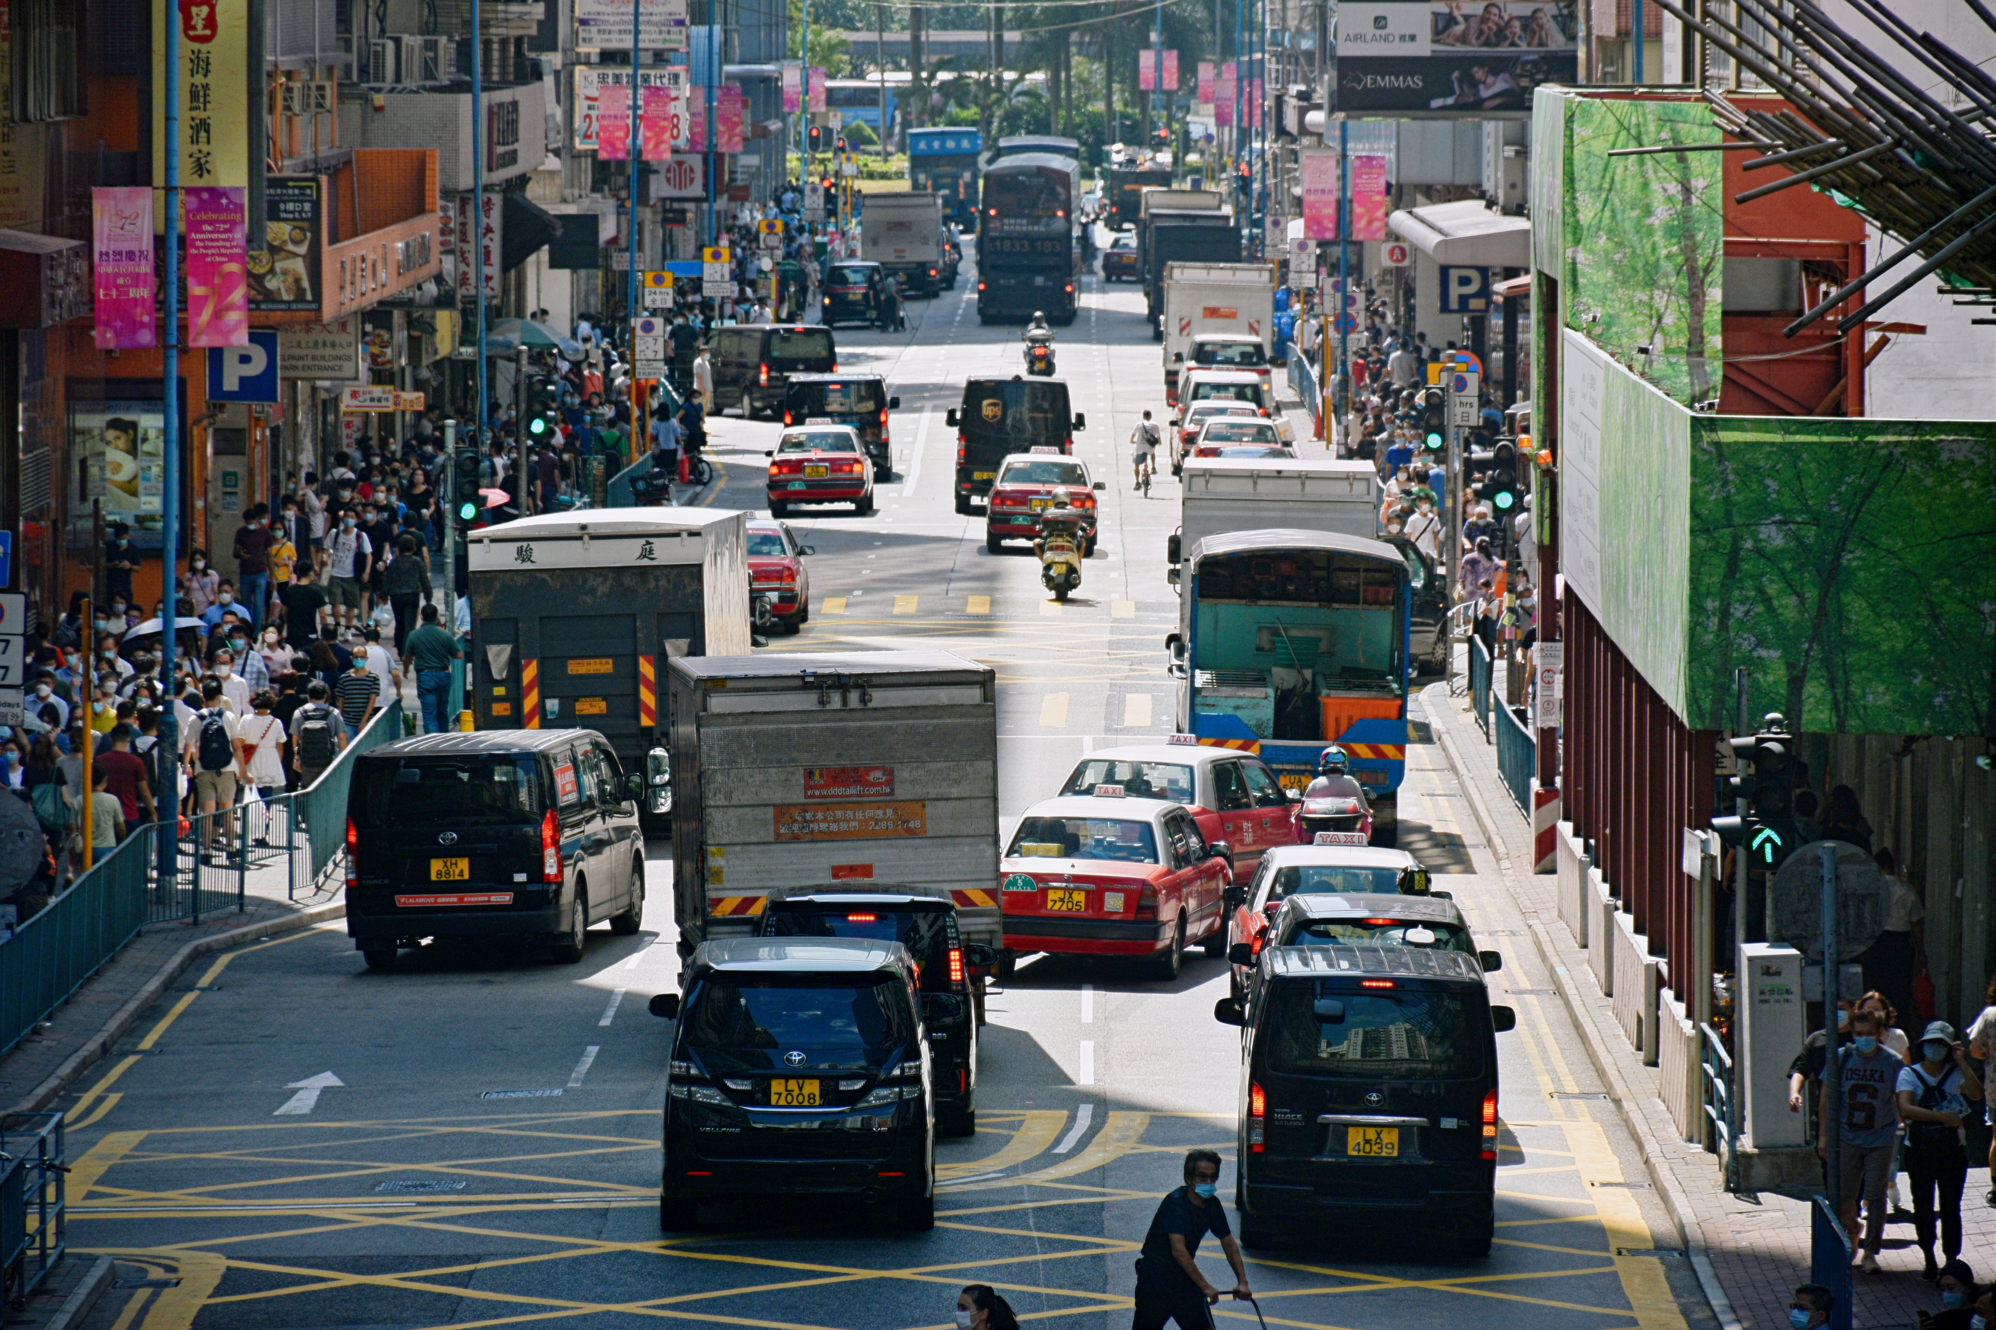

Slide 2
N

Slide 3
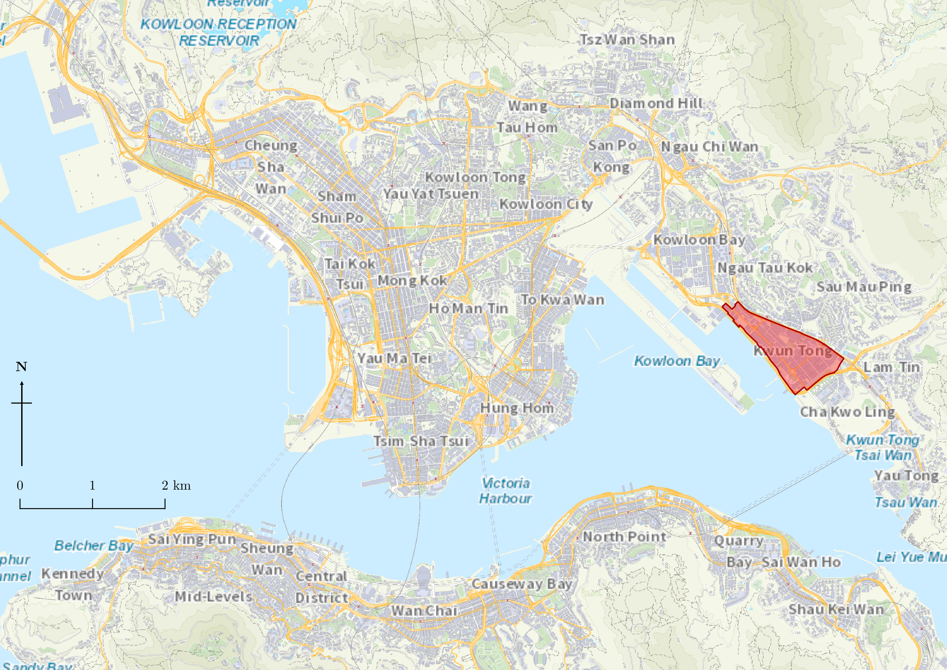
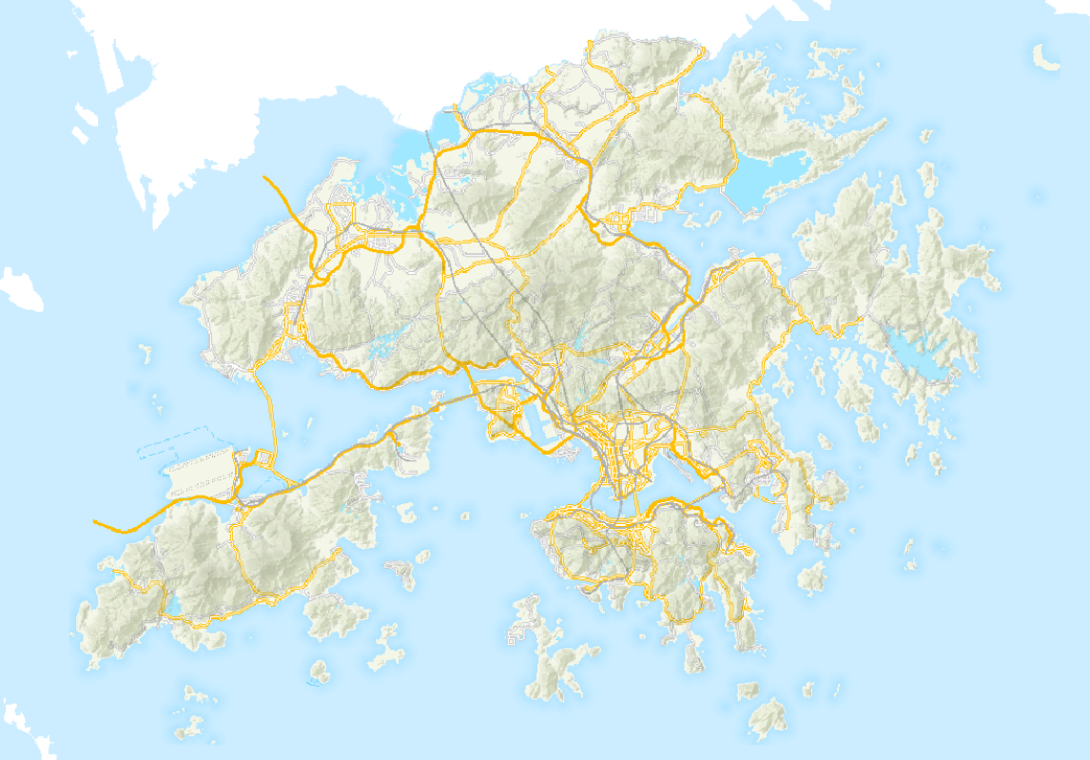
Map of HK
Located adjacent to airport
10km
Mountainous terrain and deep harbour reduces land availability
Old Kai Tak Airport
Legend
Study Area
Roads
Buildings
Sea
Terrain

Slide 4
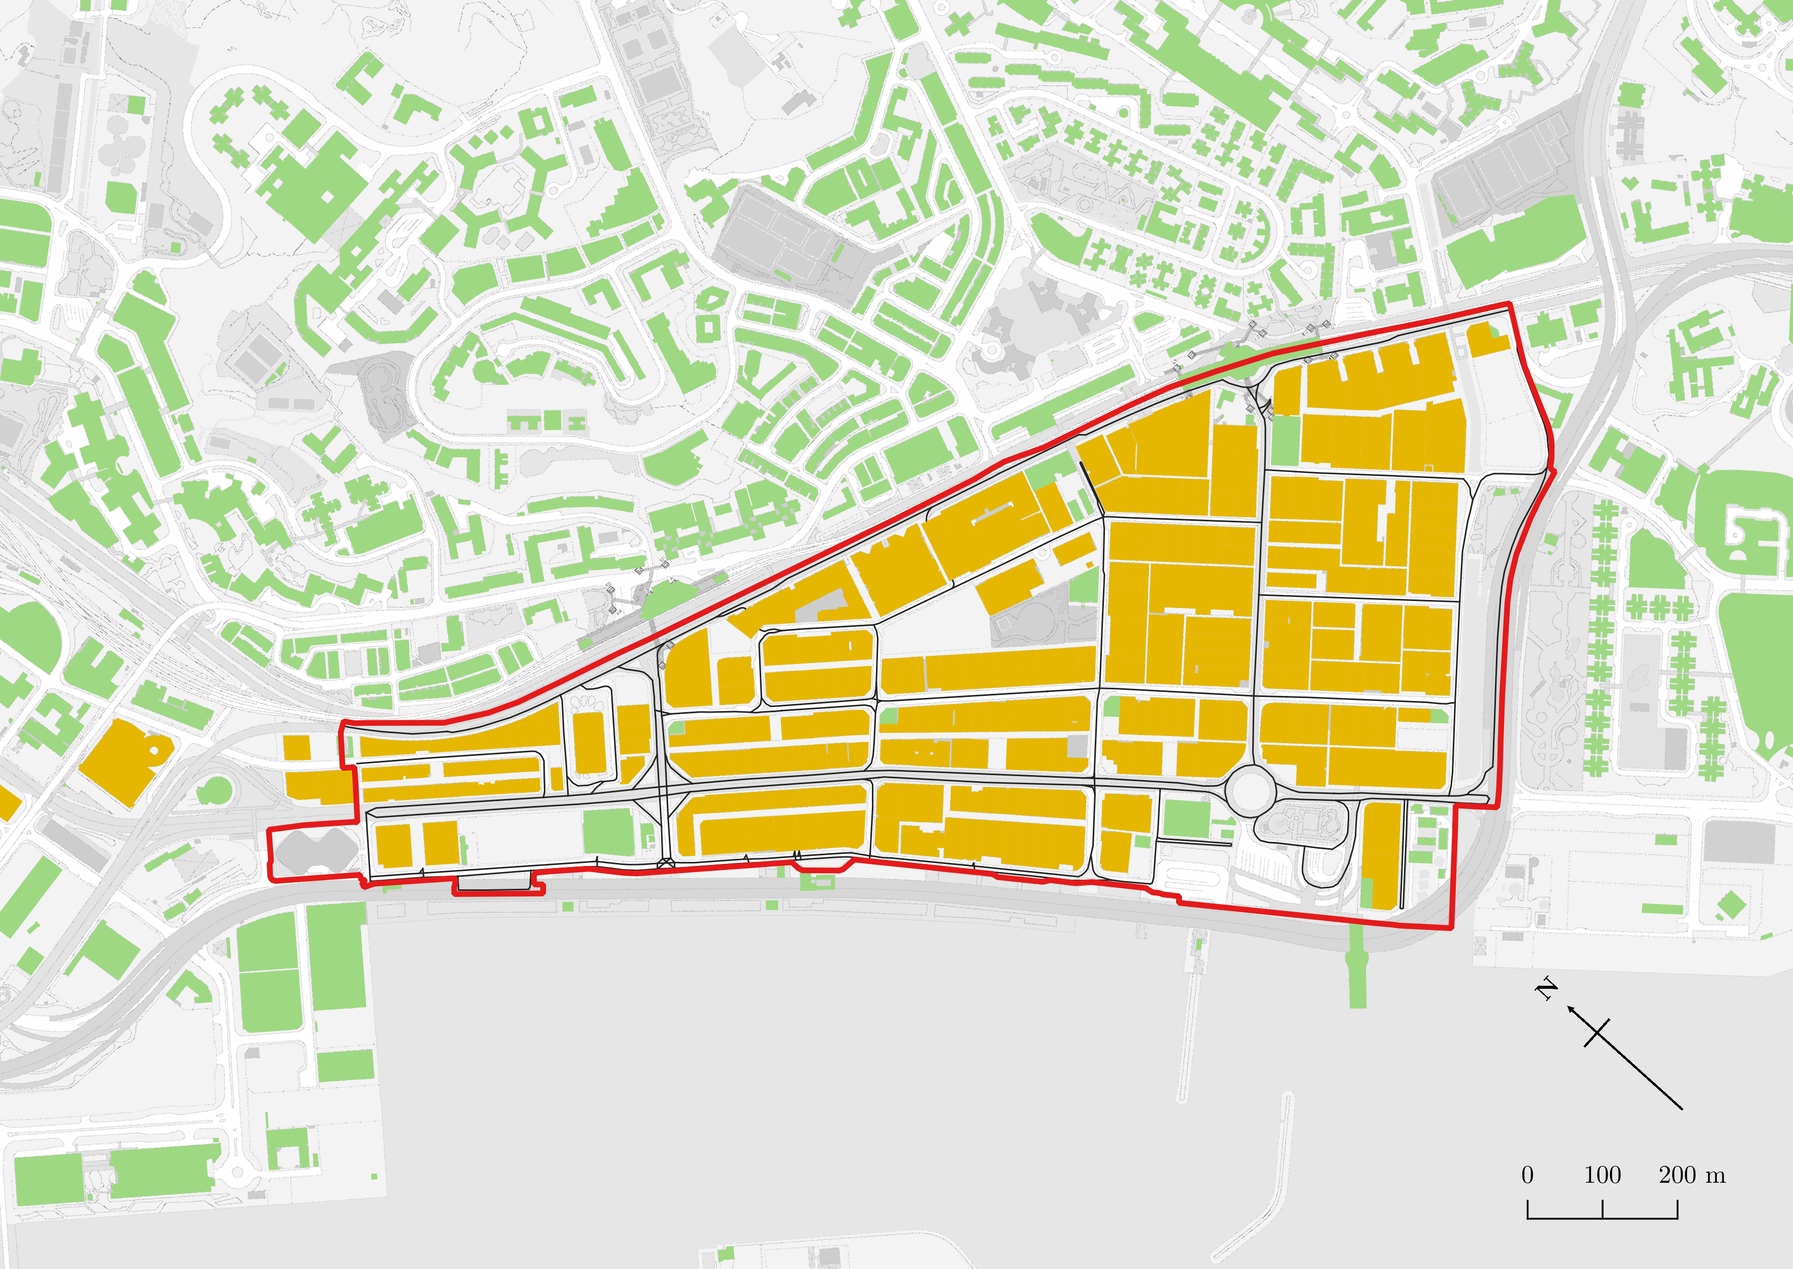
Legend
Study Area
High volume of commuters from residential districts travel into KT
Only one major road supporting entire industrial district
Industrial Land Use
Other Land Uses
Roads
Gridlocking effect introduces traffic congestion
Traditional gridded road infrastructure

Slide 5
Obtain iB1000 map from Lands Department
Obtain “Road Network (2nd generation)” map from Lands Department
Extract street centrelines
Extract all buildings within study area
Construct directed node graph
Generate list of demand nodes
Generate list of parking facilities
5.1.2
5.1.3
Select strategic survey points
Generate sample points
Estimate demand with GFA
Estimate supply with GFA
Perform on-site traffic counting
Perform modified Ga2SFCA for each sample
Generate origin-to-destination matrices
Analyse results
Compute Spearman Rank Correlation Coefficient
Validate/invalidate hypothesis
Compute t-value

Slide 6
Obtain iB1000 map from Lands Department
Extract list of off-street parking facilities from HKeMobility website
Extract street centrelines
Extract all buildings within study area
5.4
Construct directed node graph
Estimate gross floor area with building height and area
Estimate number of parking spaces using gross floor area of the building
5.1
5.2
Select strategic survey points
Generate sample points
Generate population nodes
Prepare location of parking spaces nodes
5.3
Perform on-site traffic counting
5.4
Perform modified Ga2SFCA for each sample
Analyse results
Compute Spearman Rank Correlation Coefficient
Validate/invalidate hypothesis
Compute t-value

Slide 7
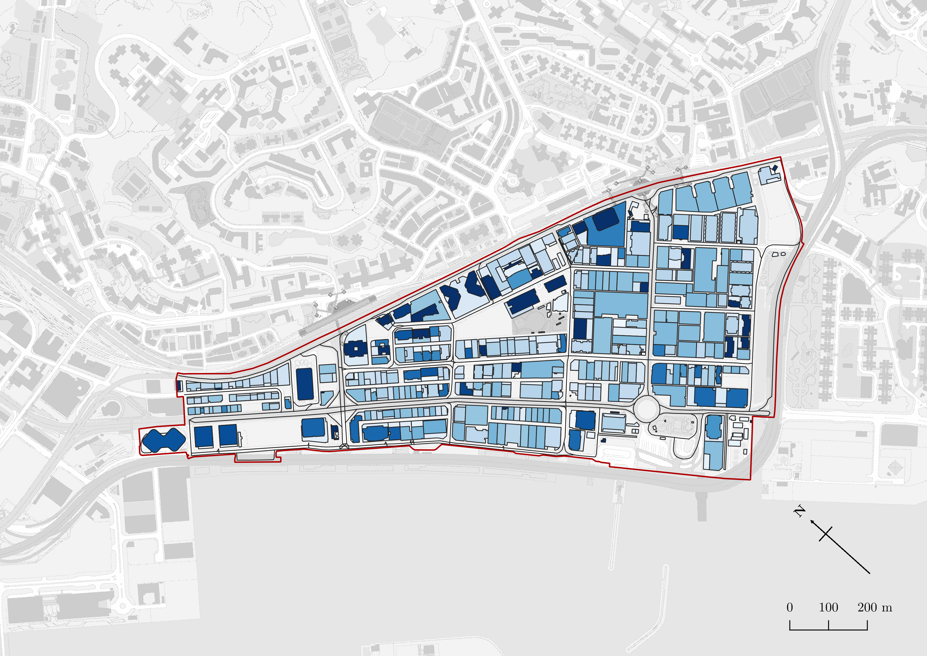
Legend
Study Area
Roads
>100 m
Building Height
0 m

Slide 8
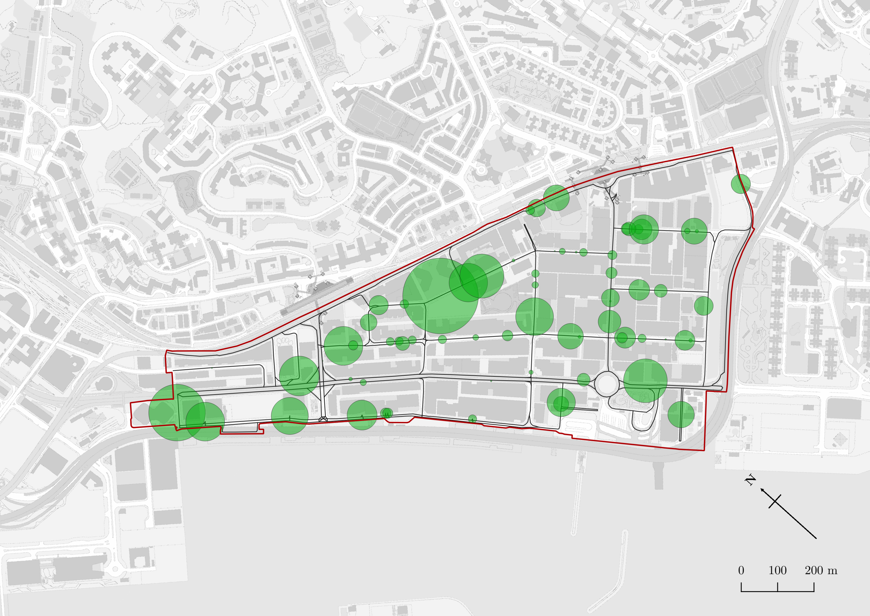
Legend
Study Area
Roads
Number of parking spaces (radius of circle corresponds to amount)
455

Slide 9
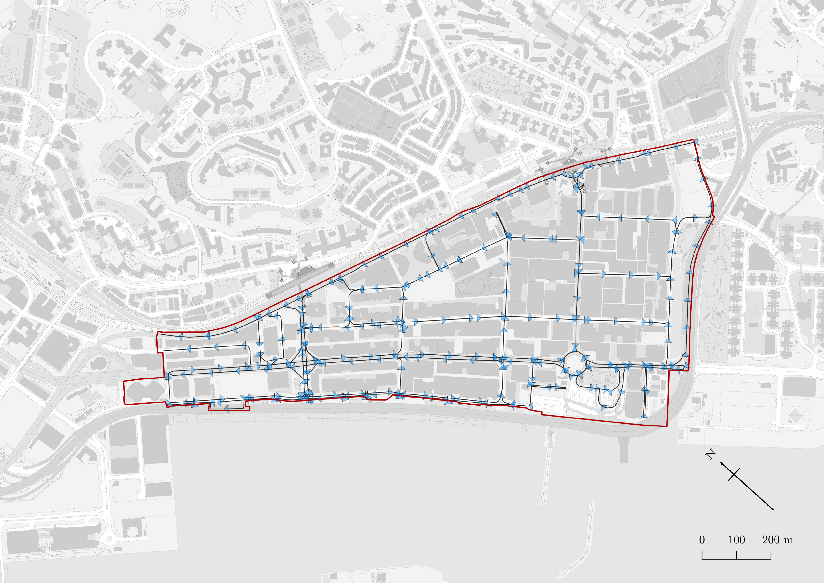
Legend
Study Area
Roads and direction
Shortest path from carpark #67 to #31
455

Slide 10
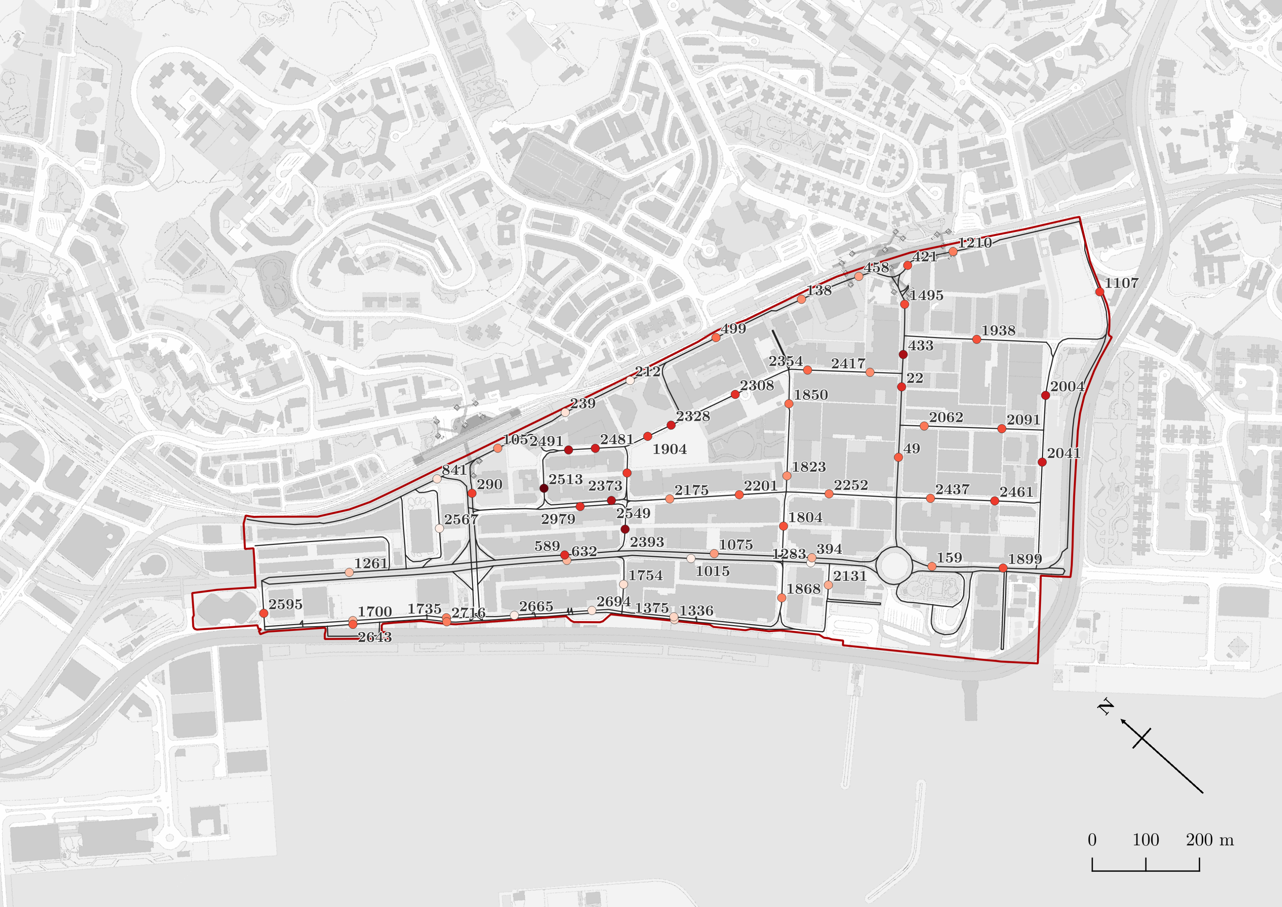
Legend
Study Area
Roads
Survey Points and their ID
0.173
Accessibility of Survey Points
0

Slide 11
State: Not occupied
State: Occupied
State: Not occupied
Car
Car
Car
Direction of motion
Direction of motion
Direction of motion
Observer’s Line of sight
Observer’s Line of sight
Observer’s Line of sight
Start time
End time
Time of which line-of-sight is occupied by the vehicle

Slide 12
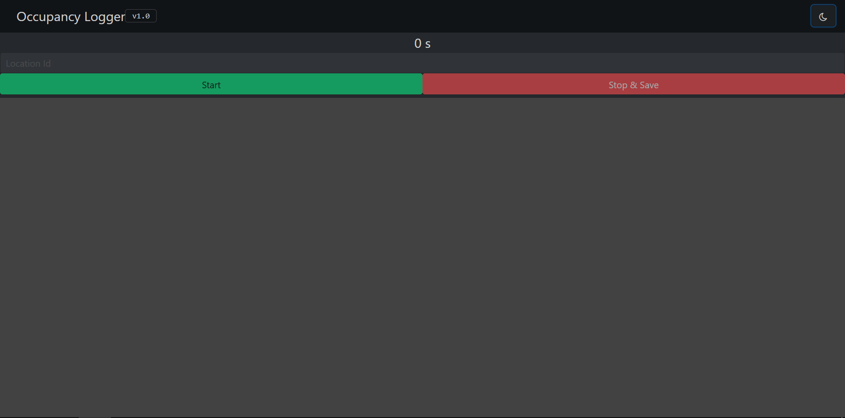
Button to start measurement
Button to stop measurement
JSON File
0.000s Not Occupied
0.688s Occupied
2.718s Not Occupied
3.142s Occupied
9.807s Not Occupied
Large area for touch-based measurements, allowing high accuracy

Slide 13
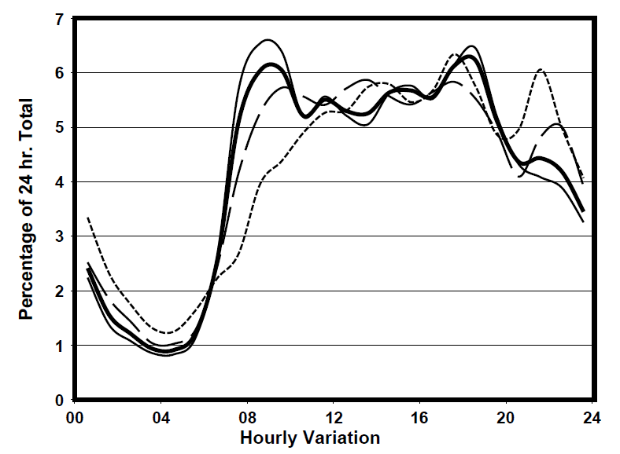
10:00-17:00

Slide 14

Rank by increasing order
If ranks are equal, take the average
Accessibility, x
Rank of x, r(x)
Relative speed, y
Rank of y, r(y)
Difference, d
d ²
0.001698
0
5487
5
-5
25
0.003340
1
4380
3,4 3.5
-2.5
6.25
0.008747
2
4380
3,4 3.5
-1.5
2.25
0.016384
3
1252
2
1
1
0.019683
4
343
1
3
9
Sum, Σd ²
43.5
Perfect negative correlation
$−$1
R
1
Perfect positive correlation

Slide 15
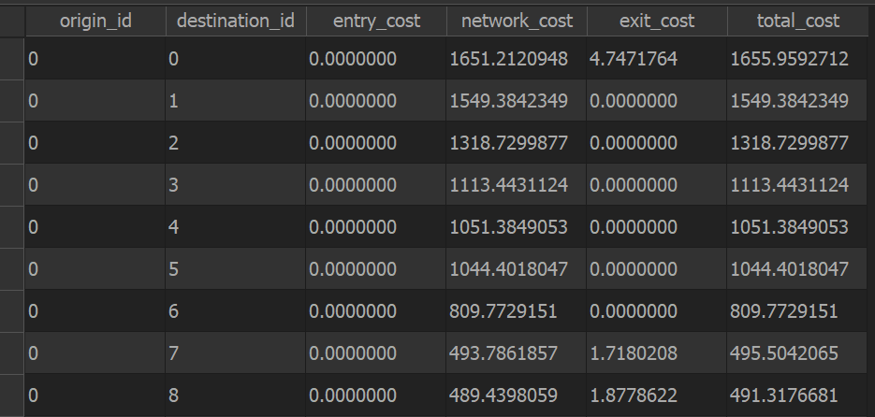
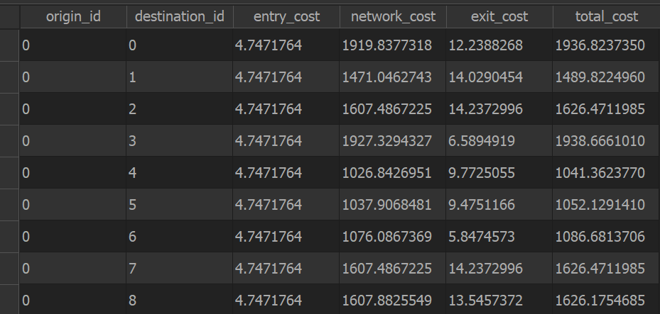
Construct directed node graphs
Create origin-destination matrices between

Slide 16
Parking facility A
Parking facility B
200
200
Consumers generally prefer facilities with greater availability of services
100
100
Movement of vehicles
Supply
Demand
Supply
Demand
SDR ratio: 0.5
SDR ratio: 2.0
Inadequate supply
inaccessible
Adequate supply
accessible

Slide 17
Searching behaviour
Cruising behaviour
Drivers often have trouble finding available parking space
Drivers willing to constantly circle area for better parking prices
Severity of congestion
Frequency of activity
Low SDR
Low parking accessibility
Inadequate supply
High SDR
High parking accessibility
Excess supply
Position of equilibrium where vehicles experience least traffic congestion

Slide 18
Parking Facility
Decreasing friction of distance
Increasingly likely to use parking facility
Probability of driver using parking facility
More likely to find another closer parking facility
Service catchment distance
Driver unwilling to use facility beyond catchment distance

Slide 19
Parking Facility
Decreasing friction of distance
Population within the catchment are likely to access parking facility
Probability of population acessing parking facility
Effective demand reduced due to distance decay
Driver
Walking is slower than driving, hence lower catchment distance
Demand catchment distance
Cost required to overcome friction of distance is too large
Service catchment distance

Slide 20
Demand catchment distance
Service catchment distance
Demand catchment distance
Distance decay effect of supply
Distance decay effect of demand

Slide 21
Graph of relative speed against accessibility
Pearson’s R : -0.356
Spearman’s R : -0.288
Relative Speed
Accessibility

Slide 22
Graph of relative speed against accessibility
Envelope of speed distributions shrinks towards zero as accessibility increases
Relative Speed
Relative Speed
Large variance
Small variance
Cases of severe traffic congestion in areas with low accessibility
Accessibility to parking spaces
Accessibility to parking spaces

Slide 23
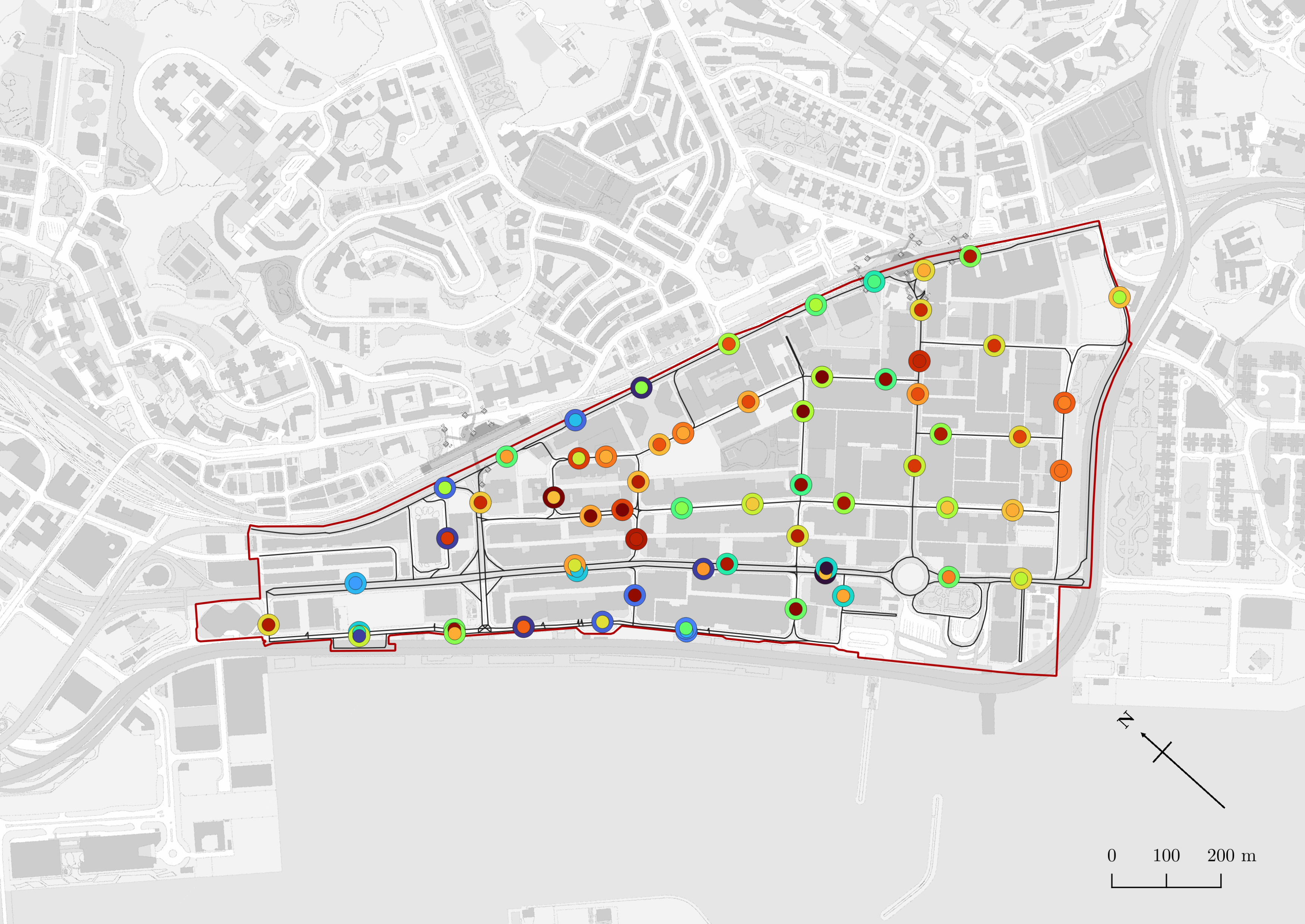
Legend
Study Area
Area 3
Roads
Area 1
Traffic speed lower than expected
Outer circle: parking accessibility
Inner circle: relative traffic speed
Colour denotes magnitude of variables
Traffic speed and accessibility closely correlated
Parking accessibility
Relative traffic speed
KTR
0
0.0736
270
10252
Acronyms
KTR: KWUN TONG ROAD
SYS: SHING YIP STREET
HMS: HOW MING STREET
HYS: HING YIP STREET
HTR: HUNG TO ROAD
WYS: WAI YIP STREET
HBR: HOI BUN ROAD
KYS: KING YIP STREET
HYR: HOY YUEN ROAD
TYS: TSUN YIP STREET
CYS: CHONG YIP STREET
HTR
SYS
HMS
HMS
Area 2
HYS
Traffic speed and accessibility closely correlated
HMS
KYS
HTR
WYS
HBR
Area 4
Interpretation
Traffic speed lower than expected
mismatch in colour of suggests mismatch in prediction
Roughly equal colours suggest strong correlation between both variables

Slide 24
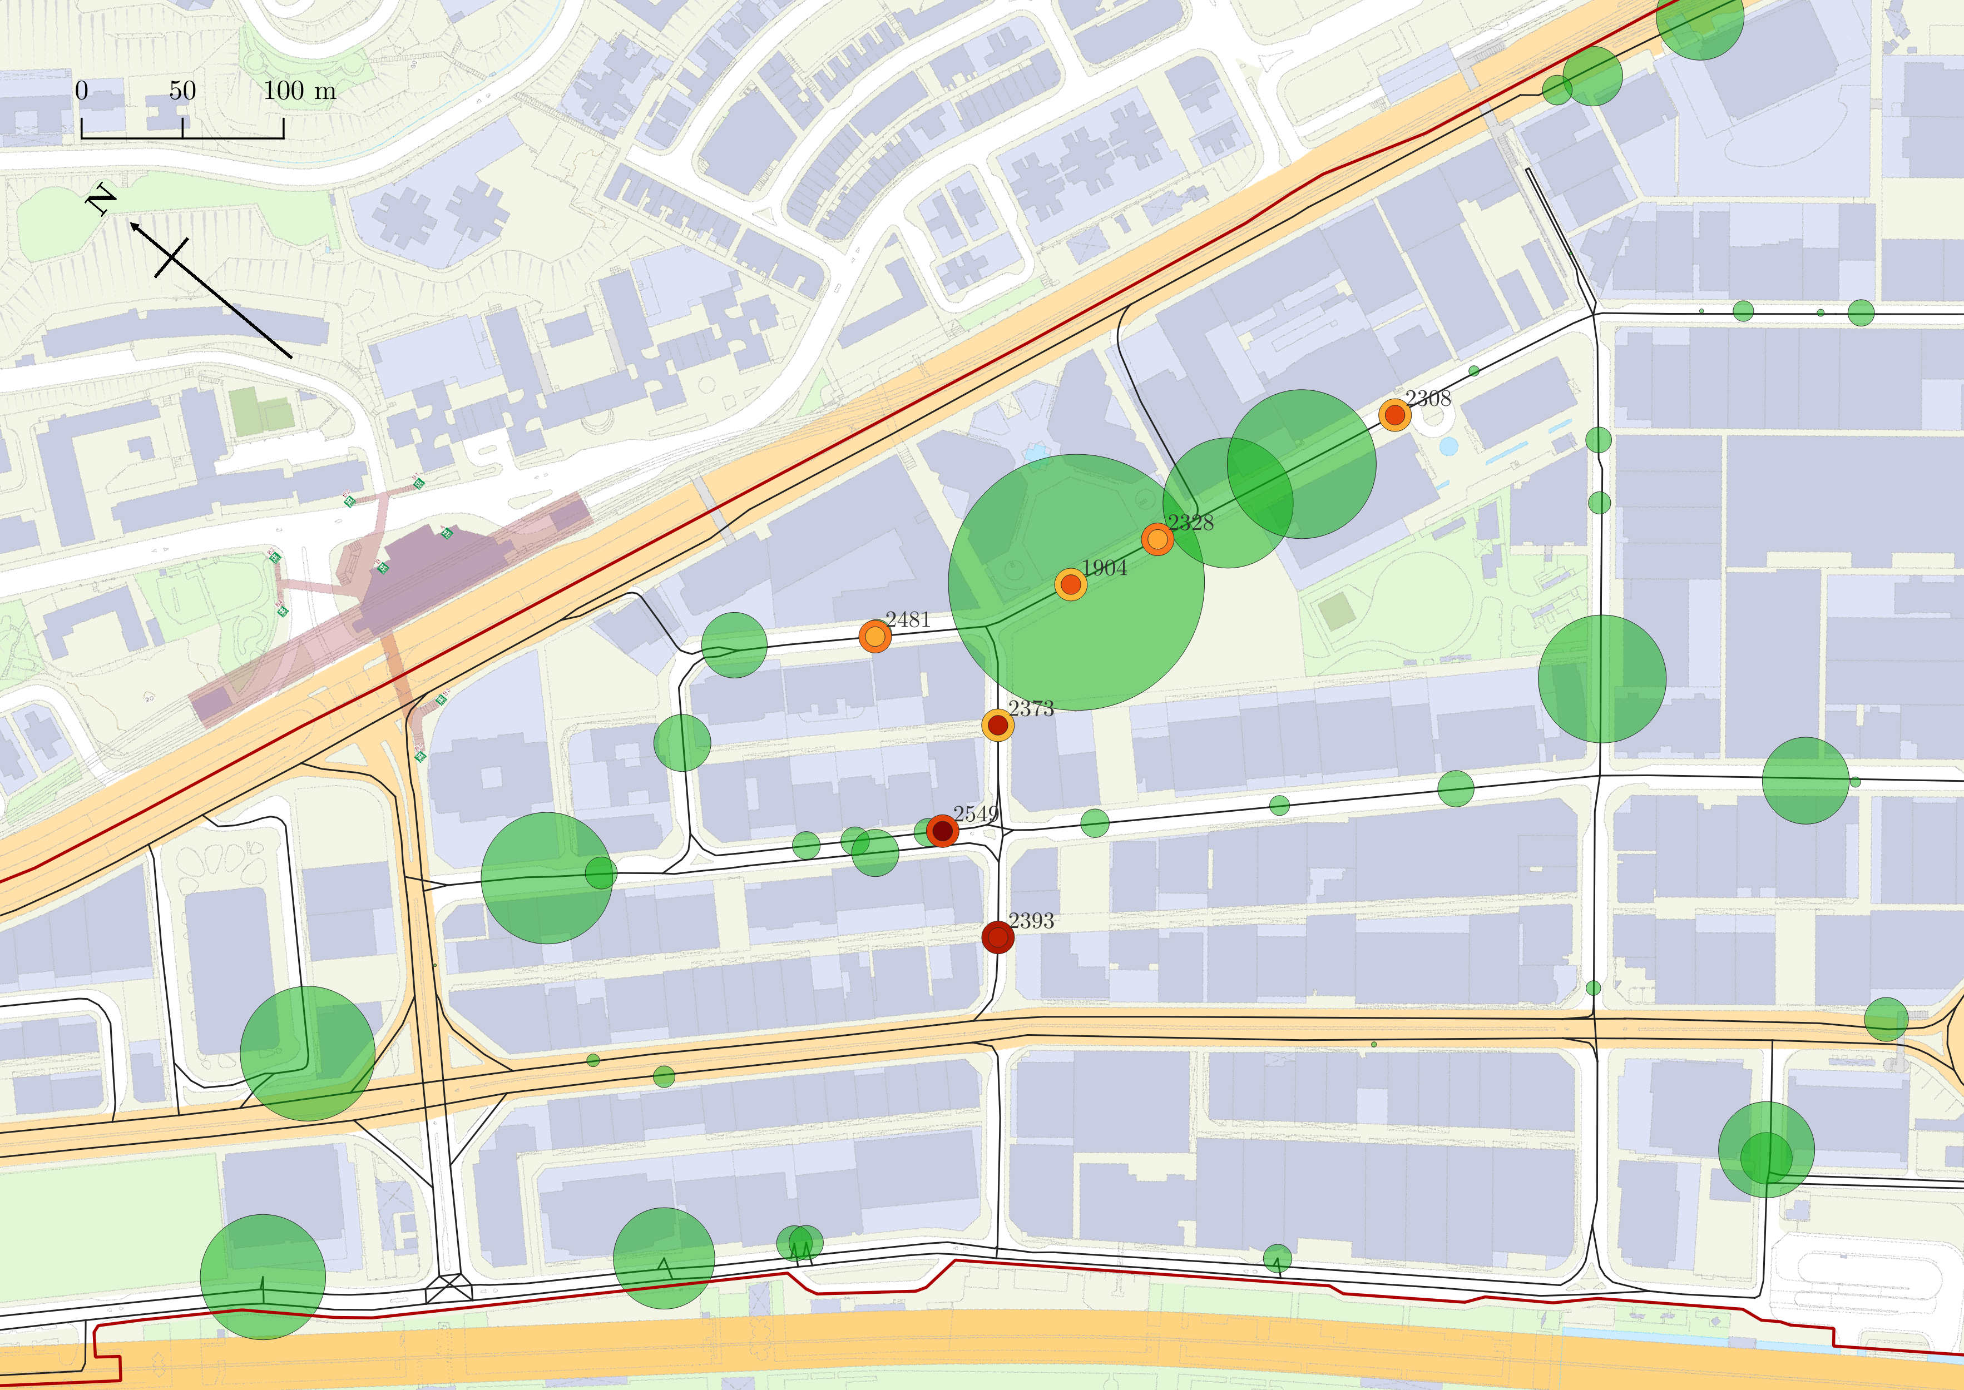
Legend
Parking accessibility
Relative traffic speed
Study Area
0
0.0736
270
10252
Roads
Outer circle: parking accessibility
Inner circle: relative traffic speed
Colour denotes magnitude of variables
Number of parking spaces (radius of circle corresponds to amount)
291
Cluster of high-supply parking spaces
Close proximity to major shopping centre (apm, Millennium City)
Overall high parking accessibility
Severe traffic congestion correctly predicted

Slide 25
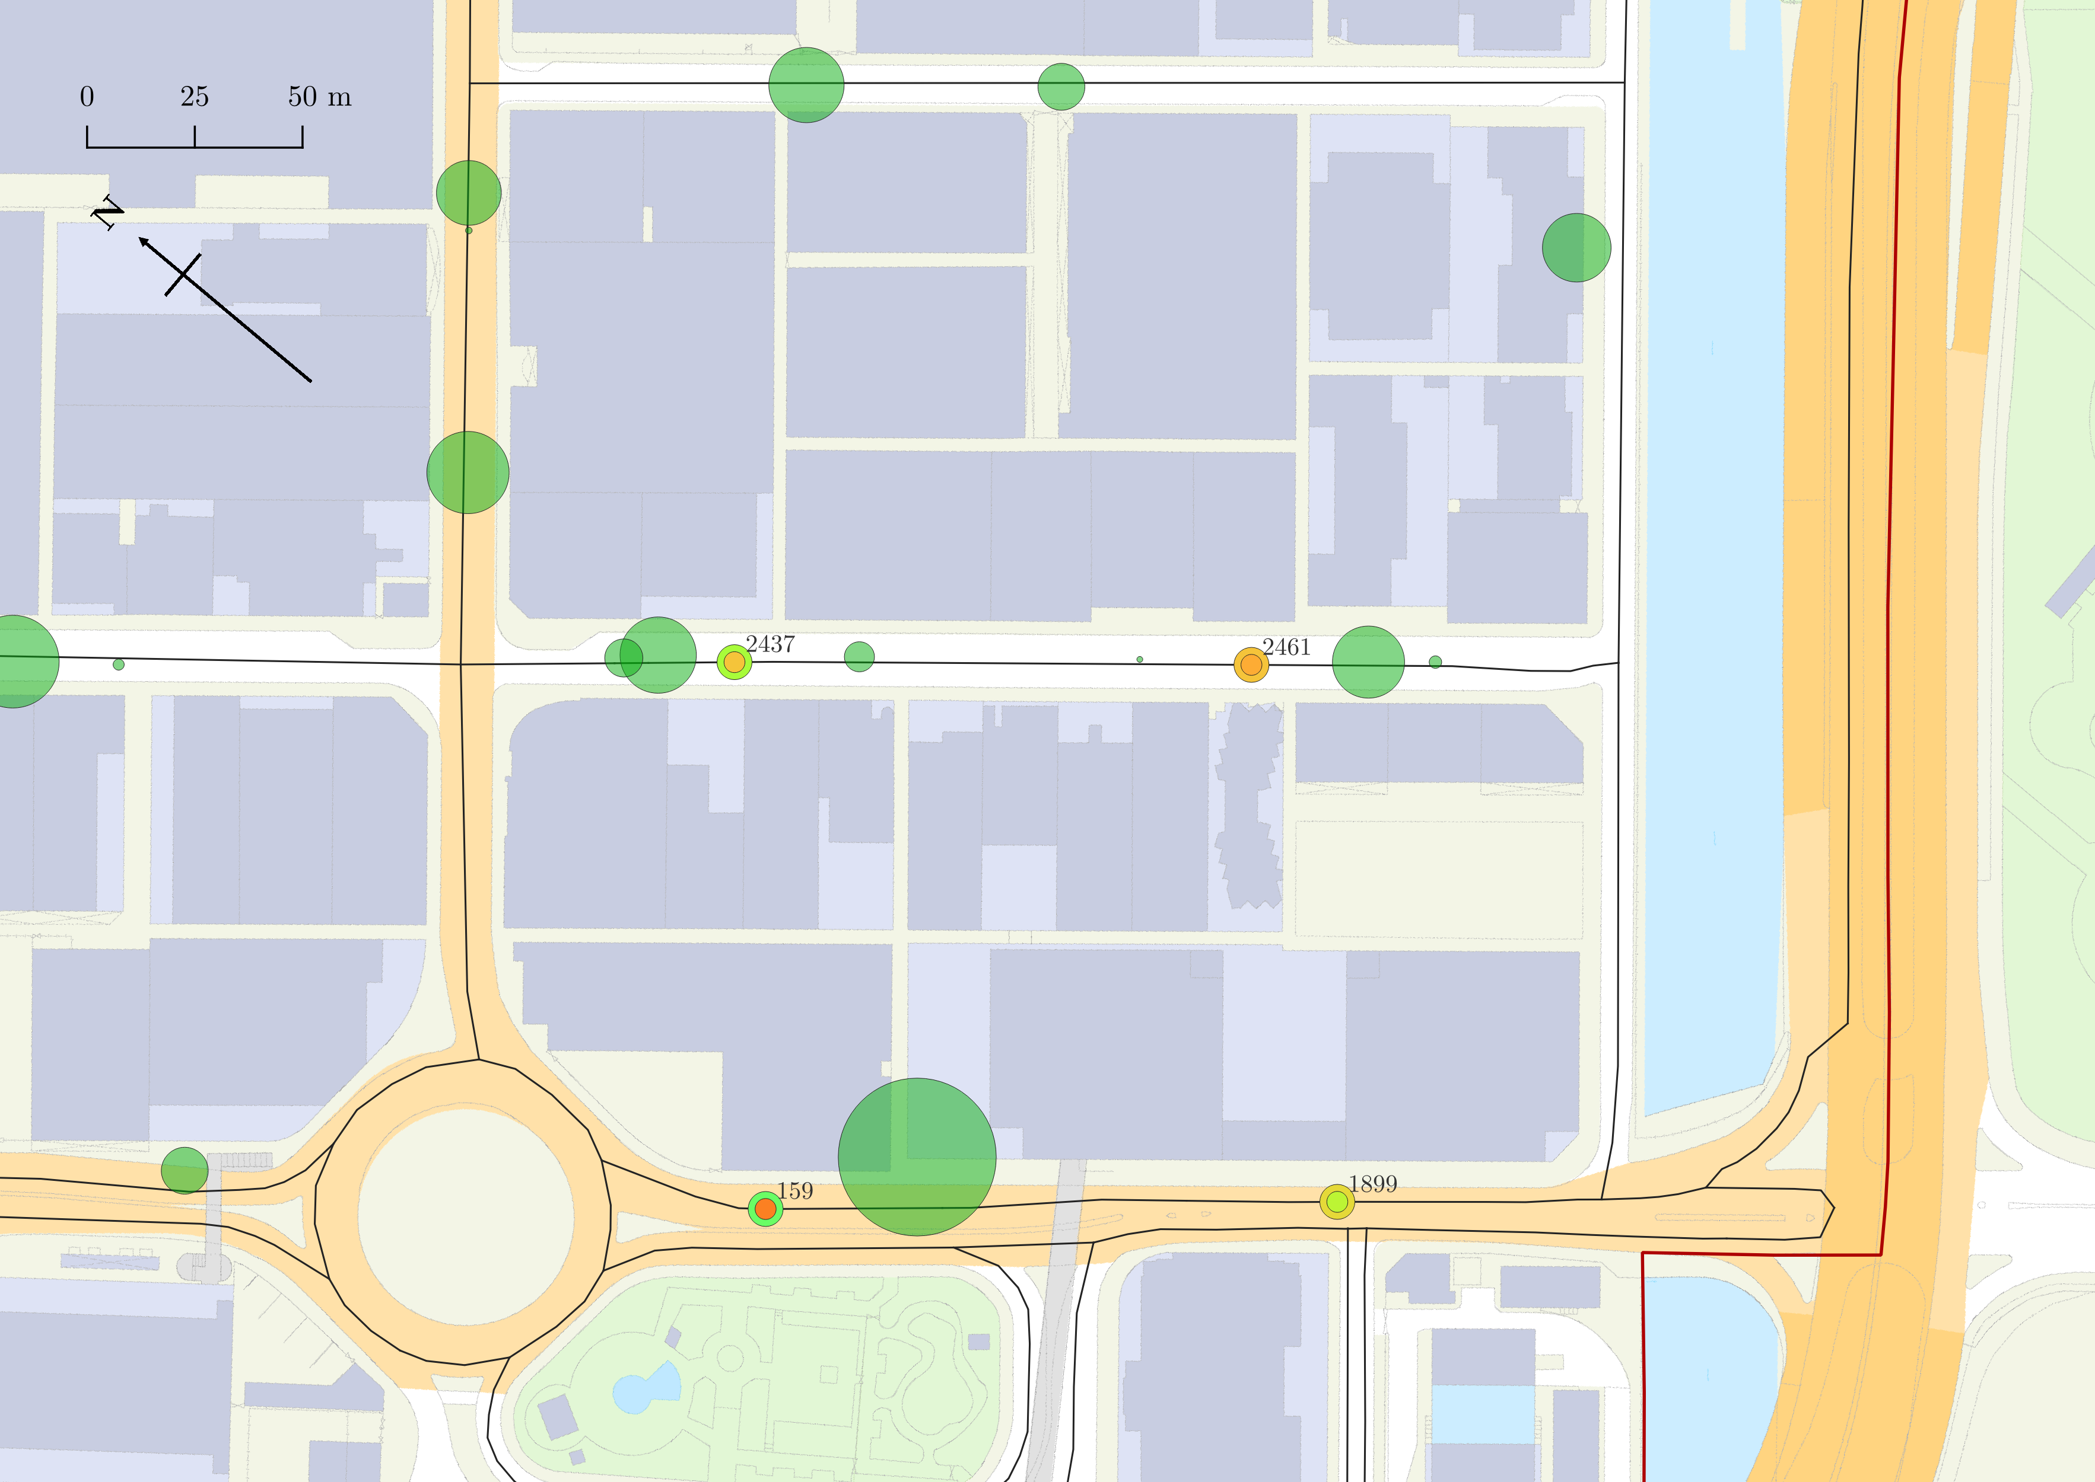
Legend
Parking accessibility
Relative traffic speed
Study Area
0
0.0736
270
10252
Roads
Outer circle: parking accessibility
Inner circle: relative traffic speed
Colour denotes magnitude of variables
Number of parking spaces (radius of circle corresponds to amount)
302
Area generally has poor parking accessibility
Number of parking spaces along KYS is very low
KYS
HTR
Traffic congestion closely correlated to parking accessibility
Arterial road that leads out of KT
WYS

Slide 26
TRASH

Slide 27
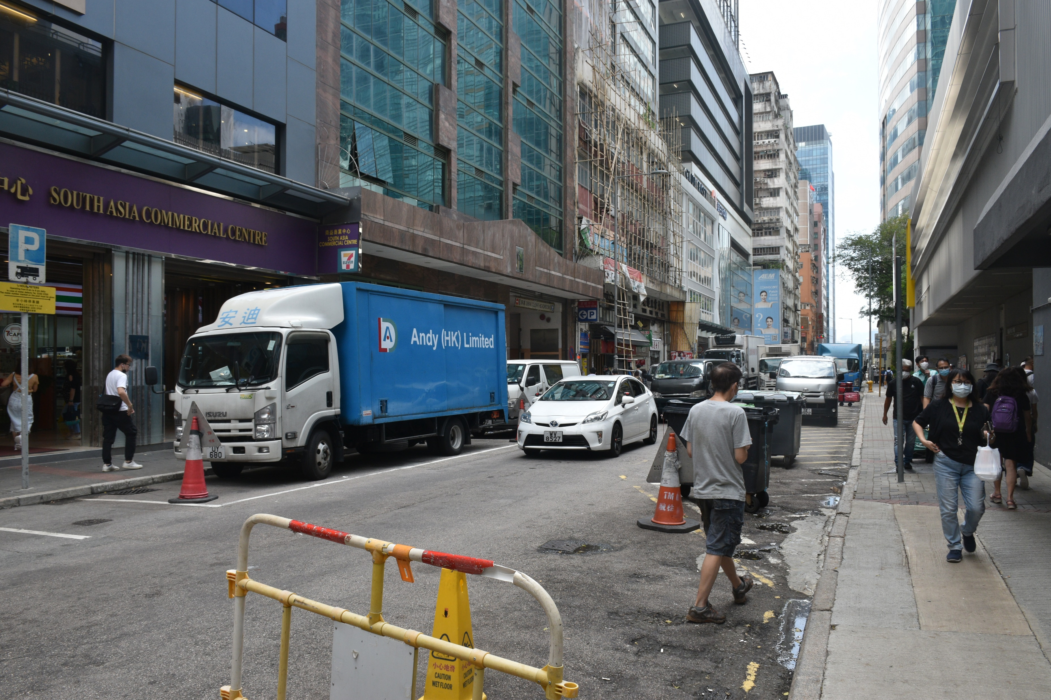

Slide 28
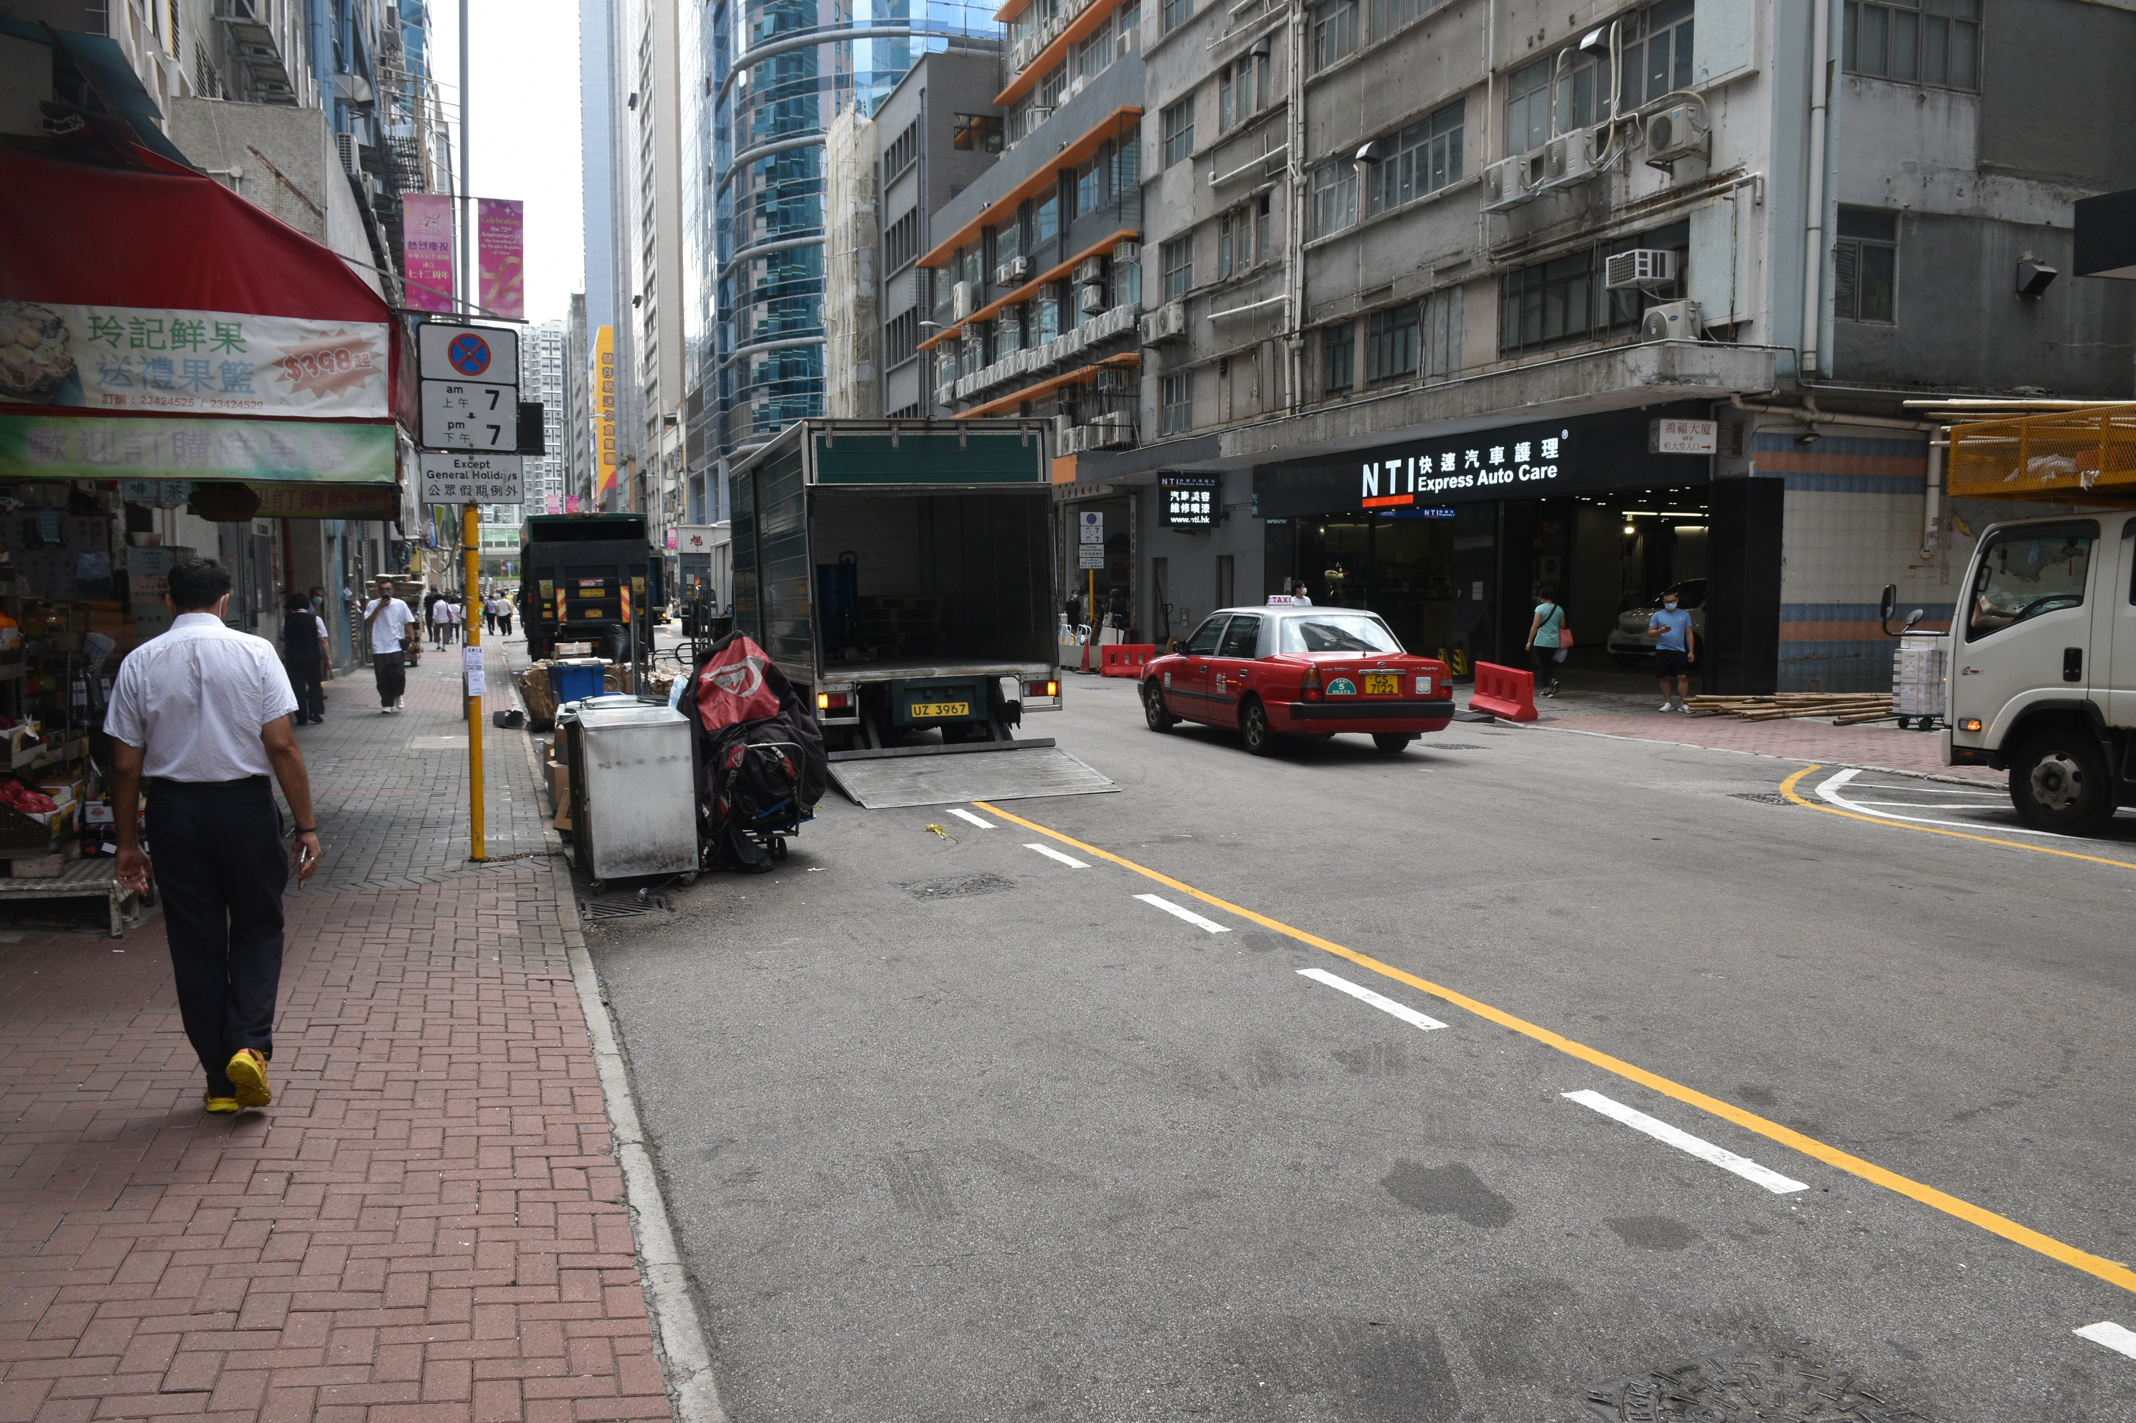
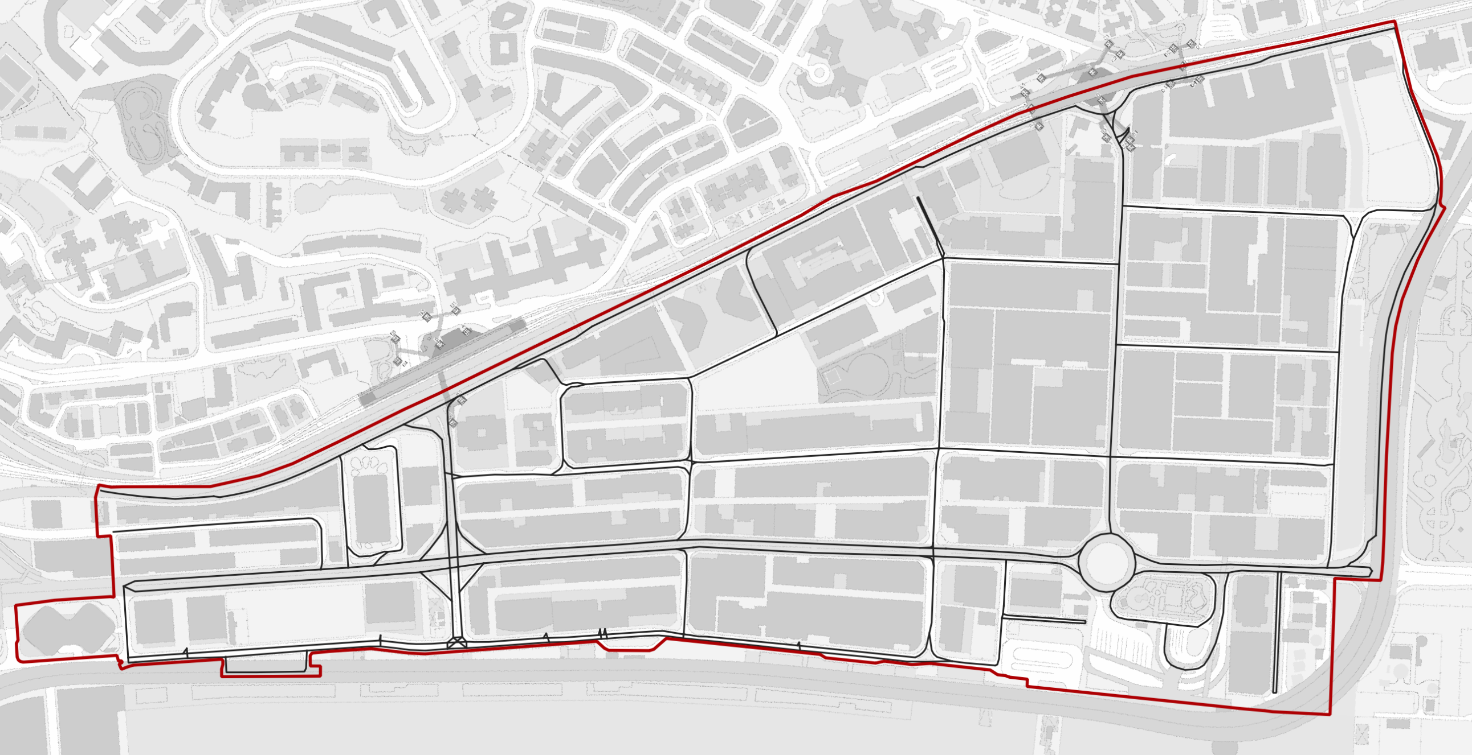
Driver forced to double park
Barricades obstructing parking space
Location
Notes:
DOUBLE PARKING

Slide 29
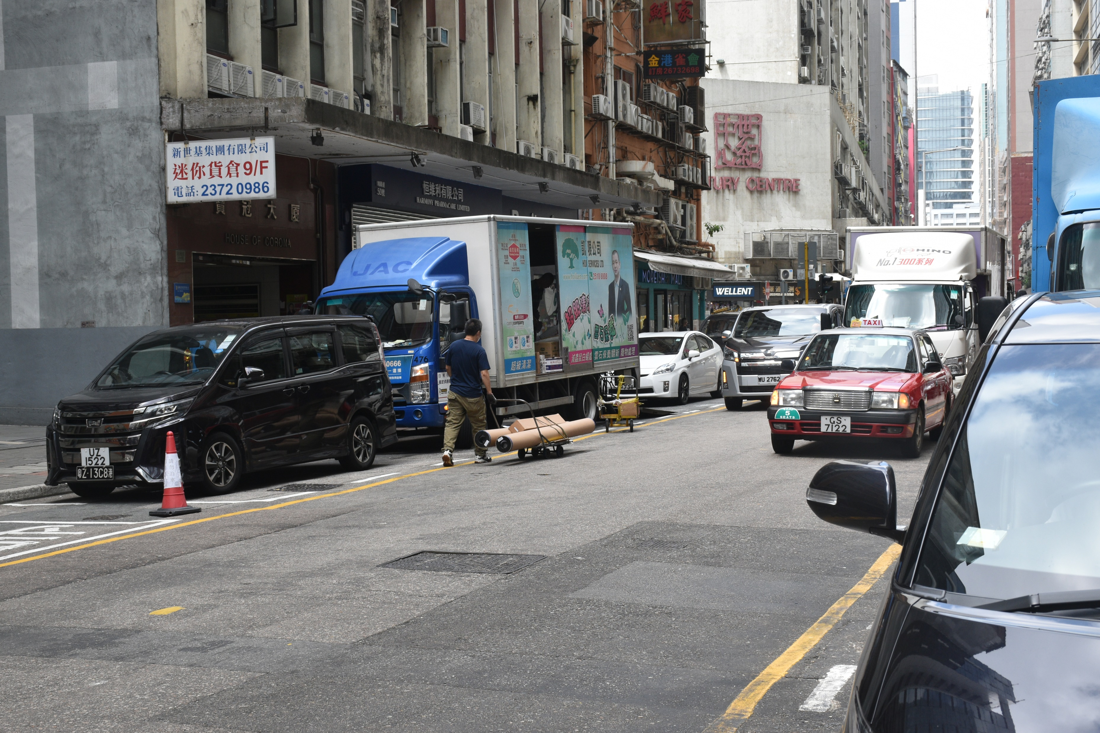
Should unload goods on kerbside
Unloading goods on the wrong side of road
Effective lanes reduced
Narrow passageway forces vehicles passing through to decrease speed
Location

Slide 30
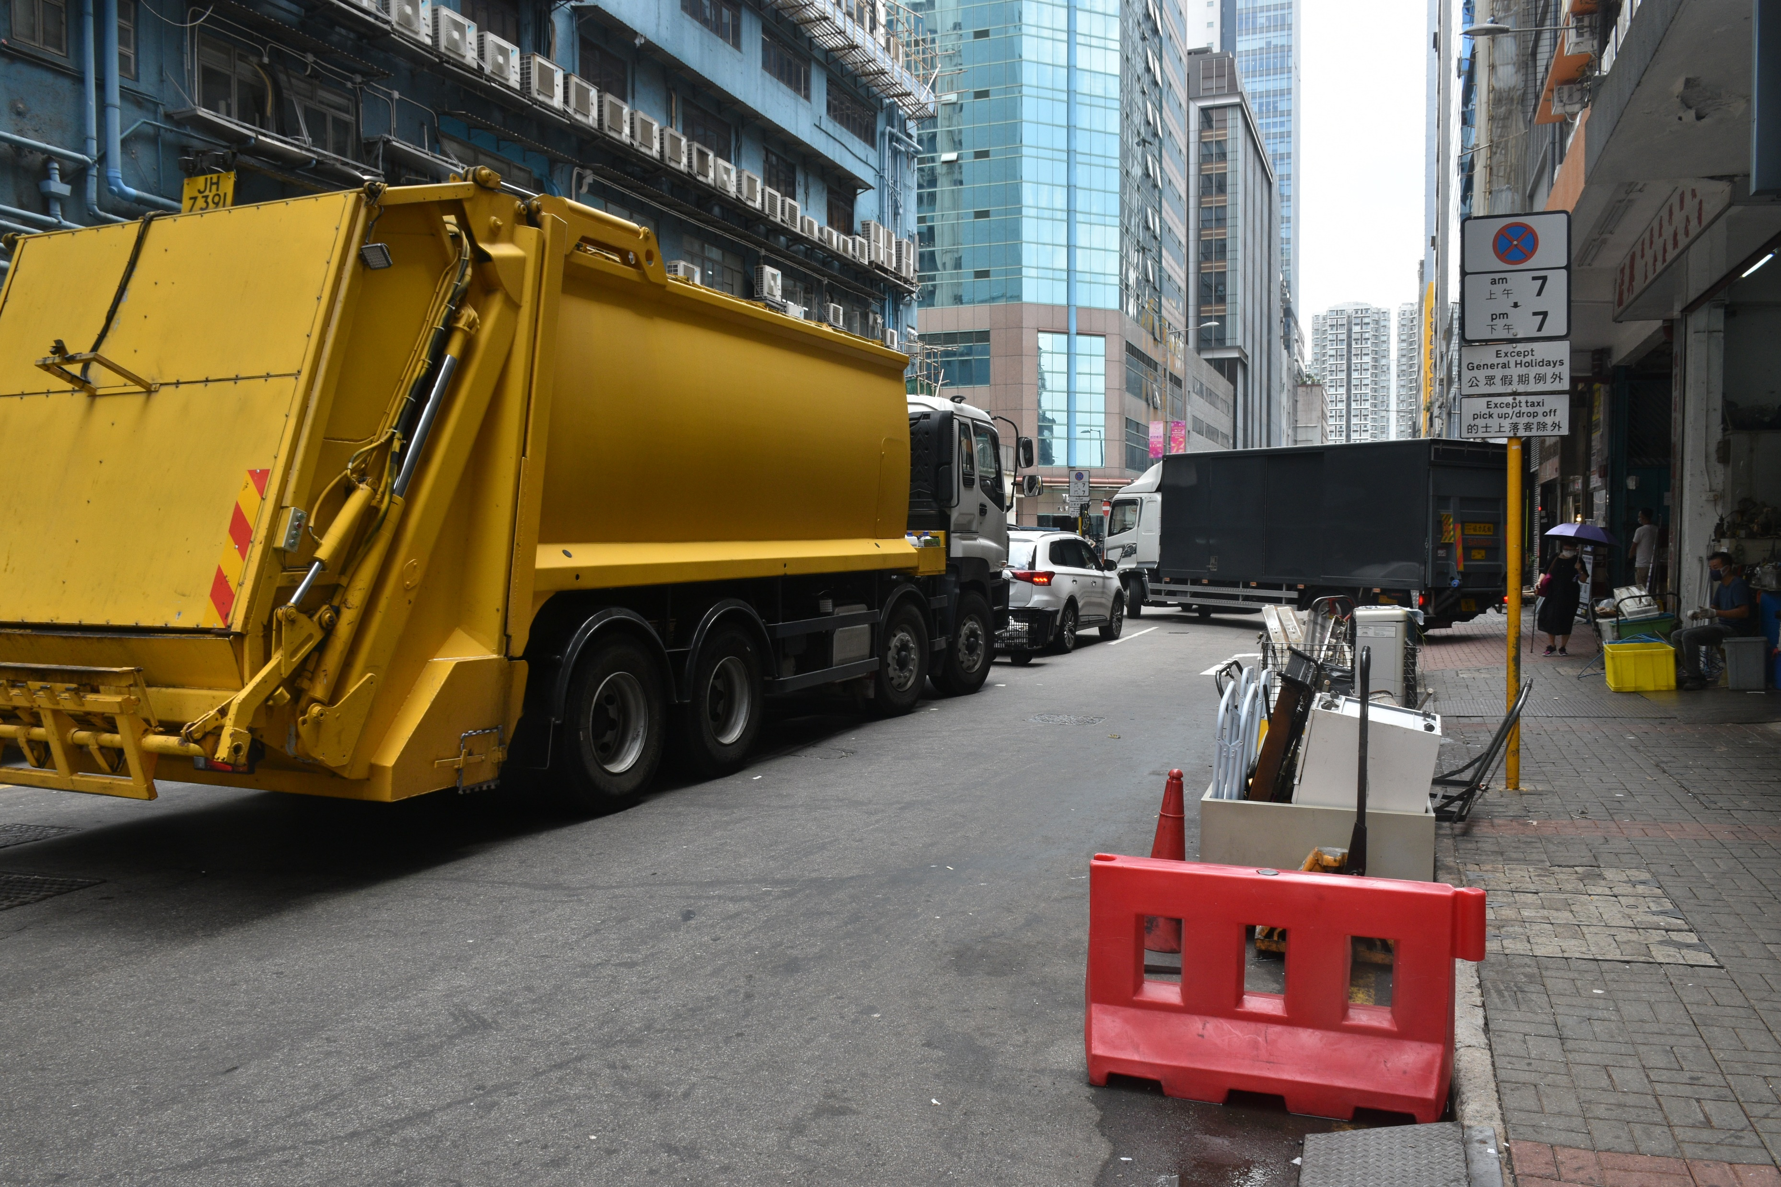
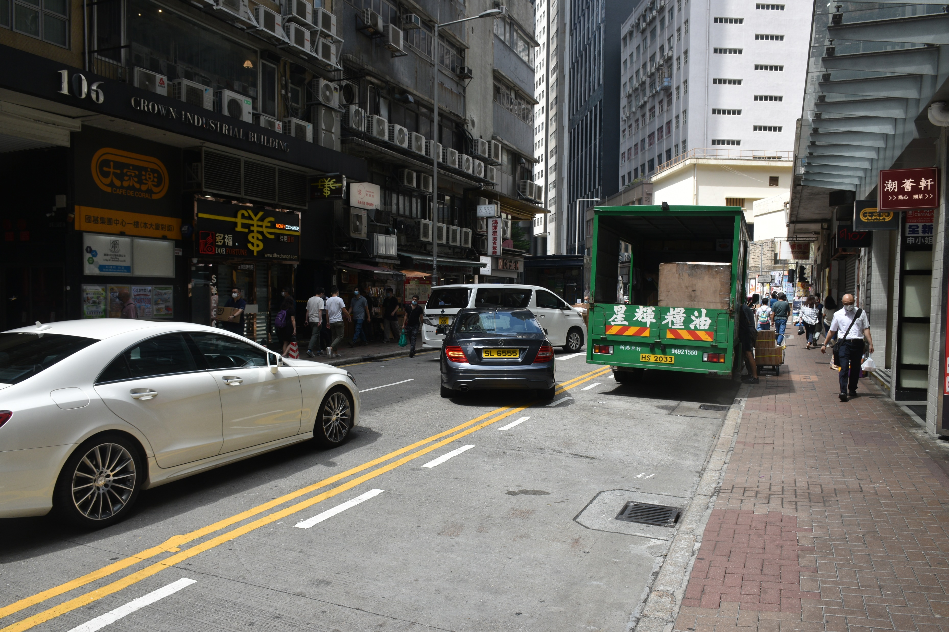
Notes:
POOR ROAD DESIGN??

Slide 31
REVAMP!!!

Slide 32
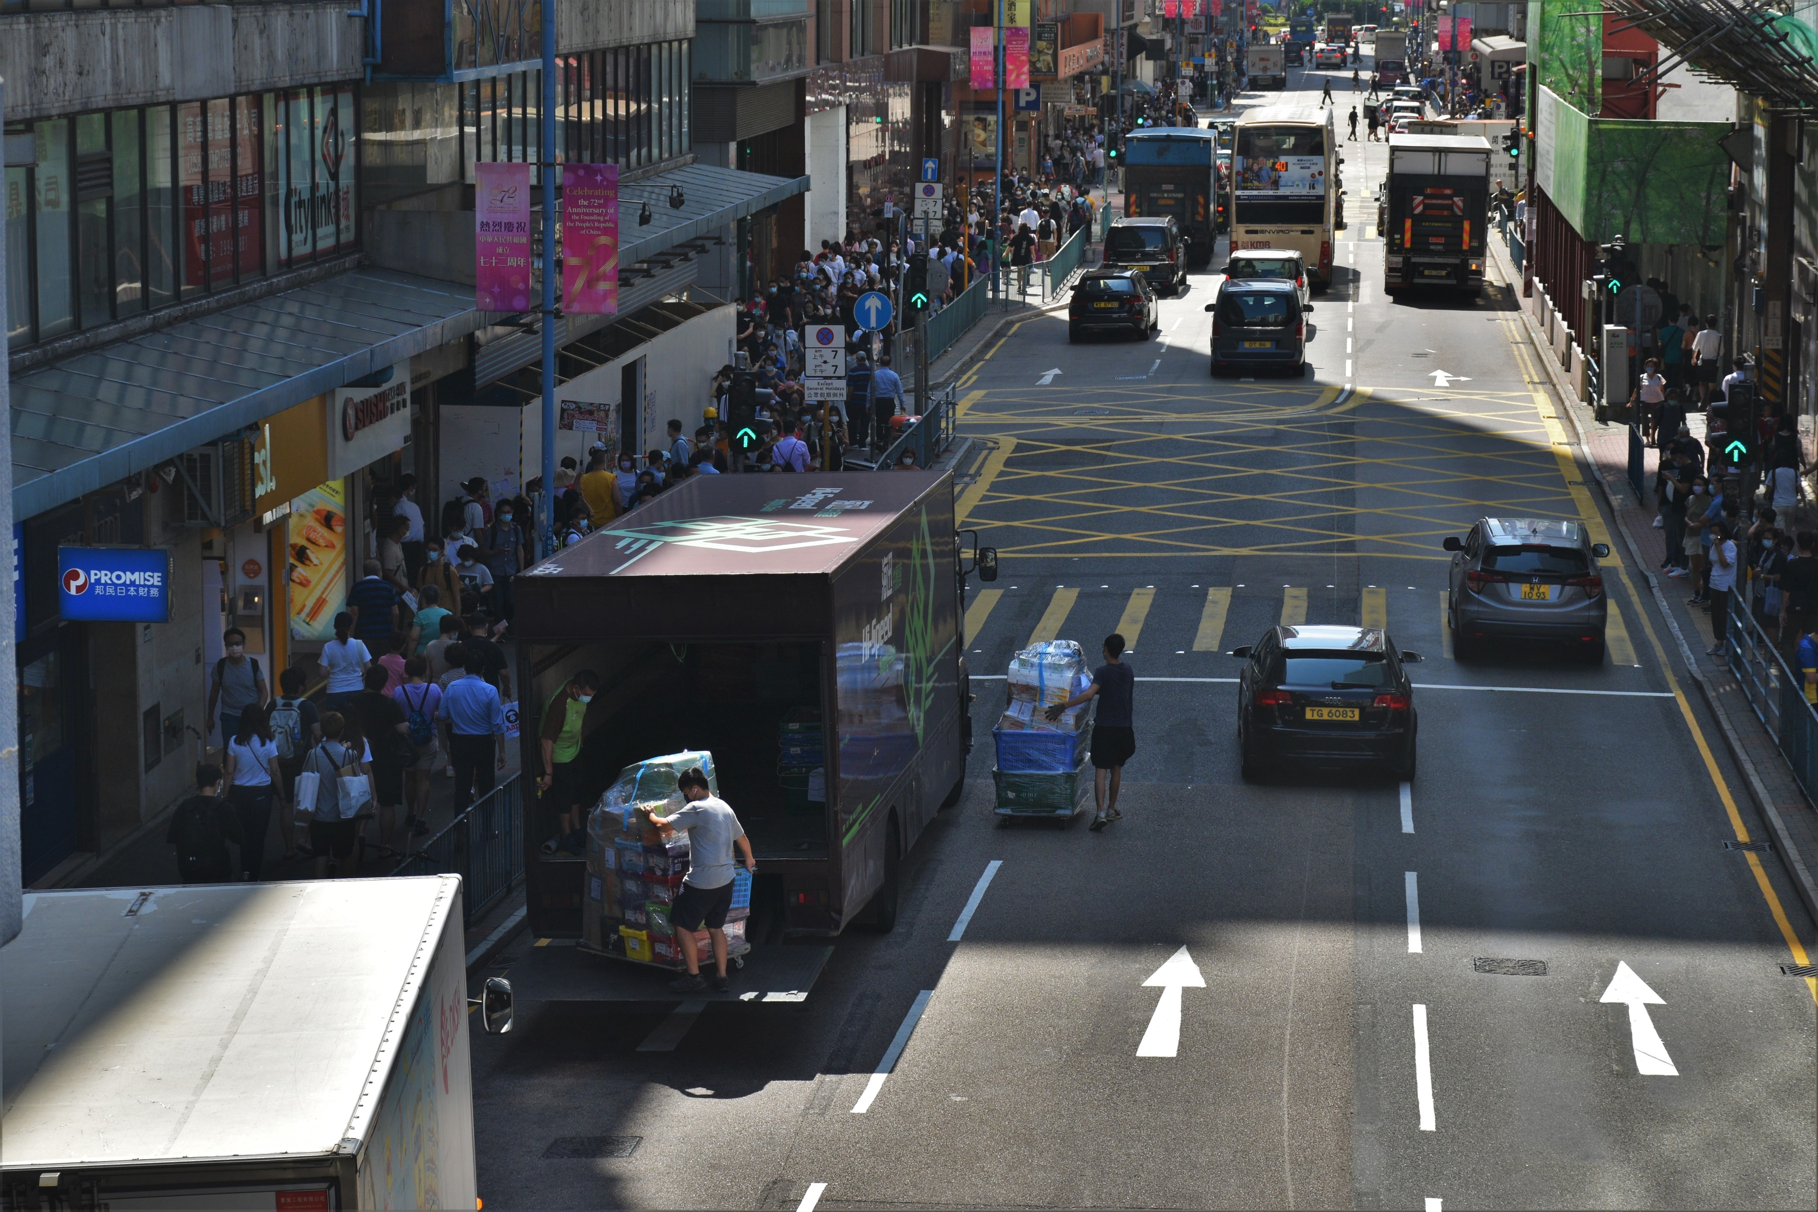
Street heavily congested by pedestrians, unsuitable for transporting goods
By law, it is prohibited to stop near traffic lights
Vehicle speed reduced to minimise risk of accidents
Usable lanes of traffic significantly reduced
150m
N
Location
vehicle stops at immediate proximity to destination

Slide 33
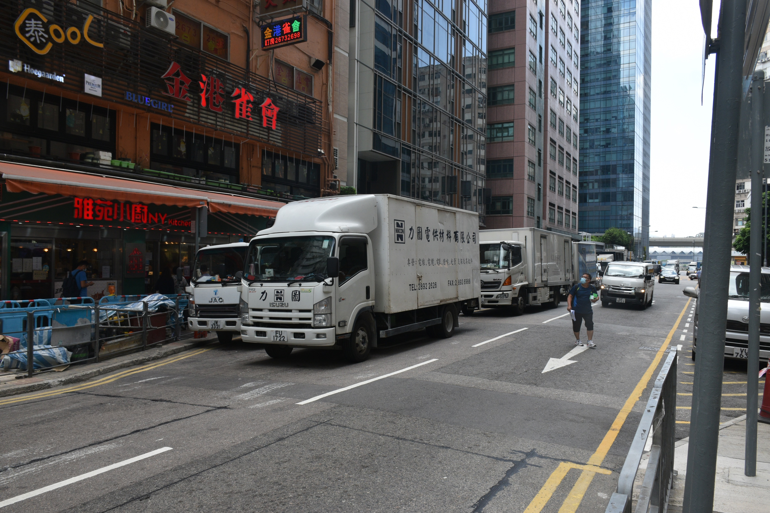
150m
N
Location
Double parking is against the law, occurs for multiple vehicles
Vehicular speed reduced significantly
Yellow hatched lines prohibit parking for long time periods
Three lanes of traffic reduced to one
Double yellow stripes prohibits vehicle stoppage

Slide 34
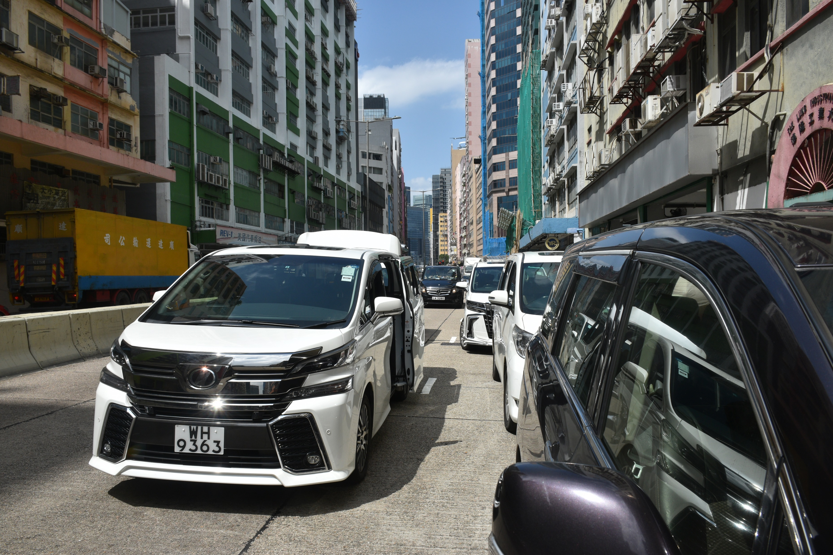
150m
N
Reducing water velocity behind, encouraging agglomeration of sediments behind
Location
Analogy: deposition of boulder in a river
Very high parking density
Vehicles behind required to merge from multiple lanes to one
Double parking occurs
Three lanes of traffic reduced to one

Slide 35
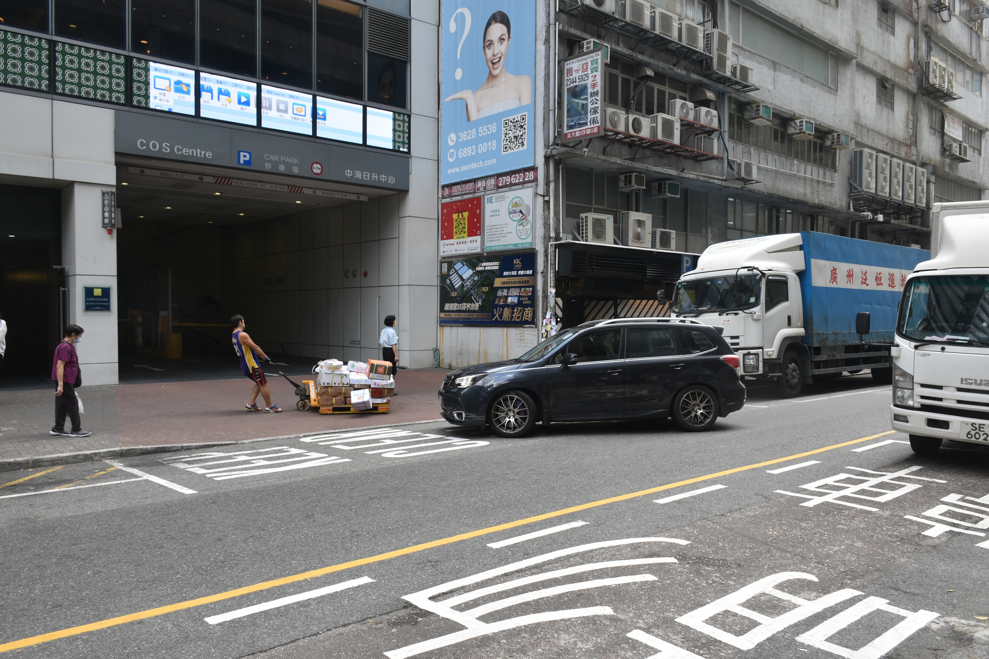
Increased wait times for traffic behind
Driver has to wait for delivery worker to clear traffic
Blocking access to car park entrance
Pallet trucks are very bulky and slow to transport
Package on trailer falls onto ground
150m
N
Location

Slide 36
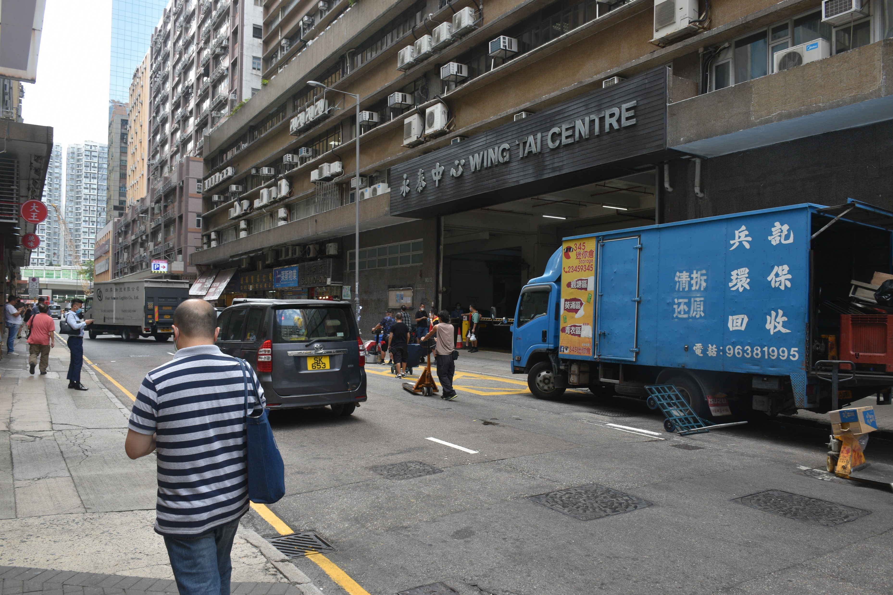
Delivery workers often do not pay attention to traffic
Group of people waiting for truck to arrive
Obstructs major entrance to industrial building
Increased awareness required to avoid collisions with mobile pedestrians
Areas with boxed yellow road markings should be kept clear
150m
N
Location

Slide 37
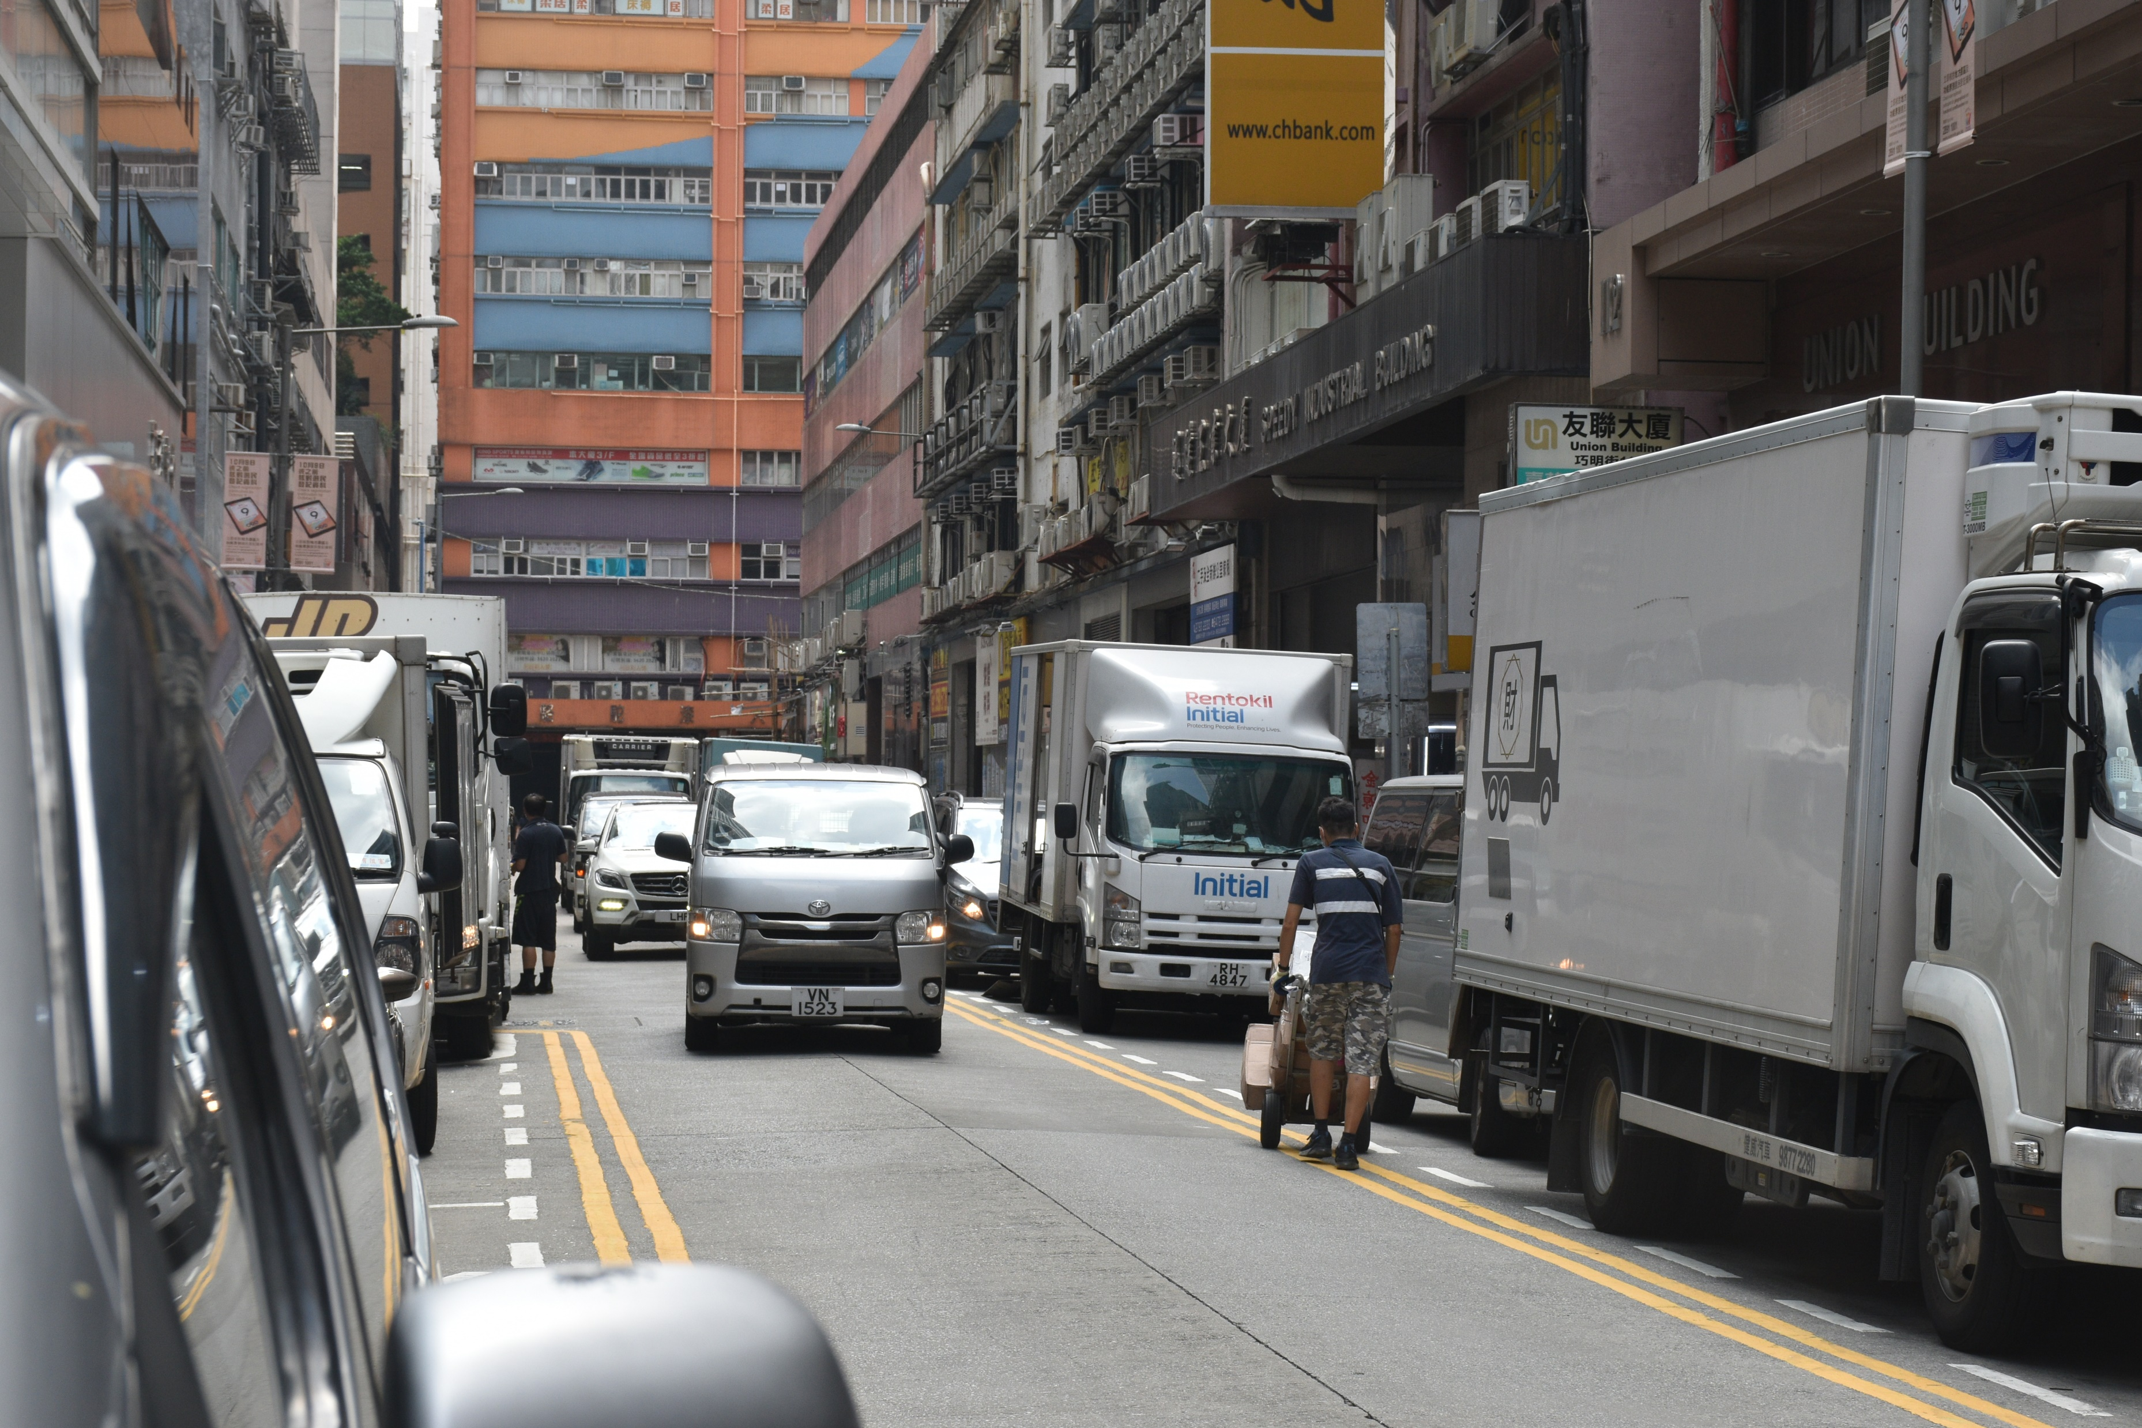
Delivery workers pays attention to goods, not traffic
Mobile pedestrians create large “danger zones”
Manoeuvring required to avoid pedestrians
150m
N
Narrow passageway forces vehicles passing through to decrease speed
Location

Slide 38
REVAMP
S2

Slide 39
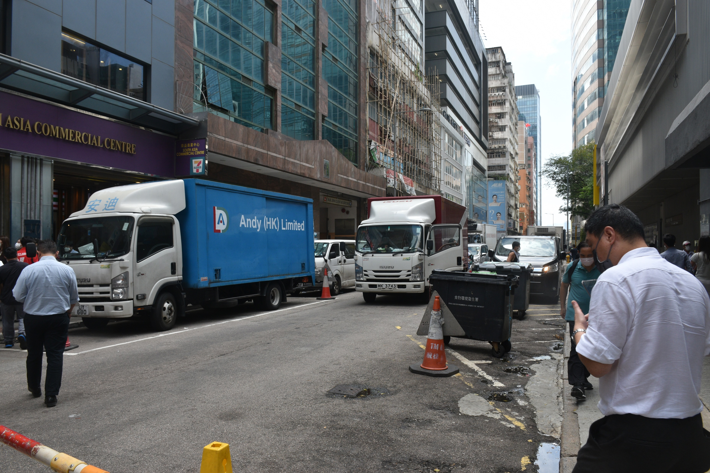
considering that barriers are unlikely to be removed
Circling the area until barricades removed will incur additional cost
Traffic backlog generated
Driver forced to unload goods with immediate proximity to destination
Immediate effect of bringing vehicular velocity behind to zero
150m
N
Barricades prevent trucks from parking
Location
Notes:
TERRITORY WIDE PARKING SPACE INSUFFICIENCY

Slide 40
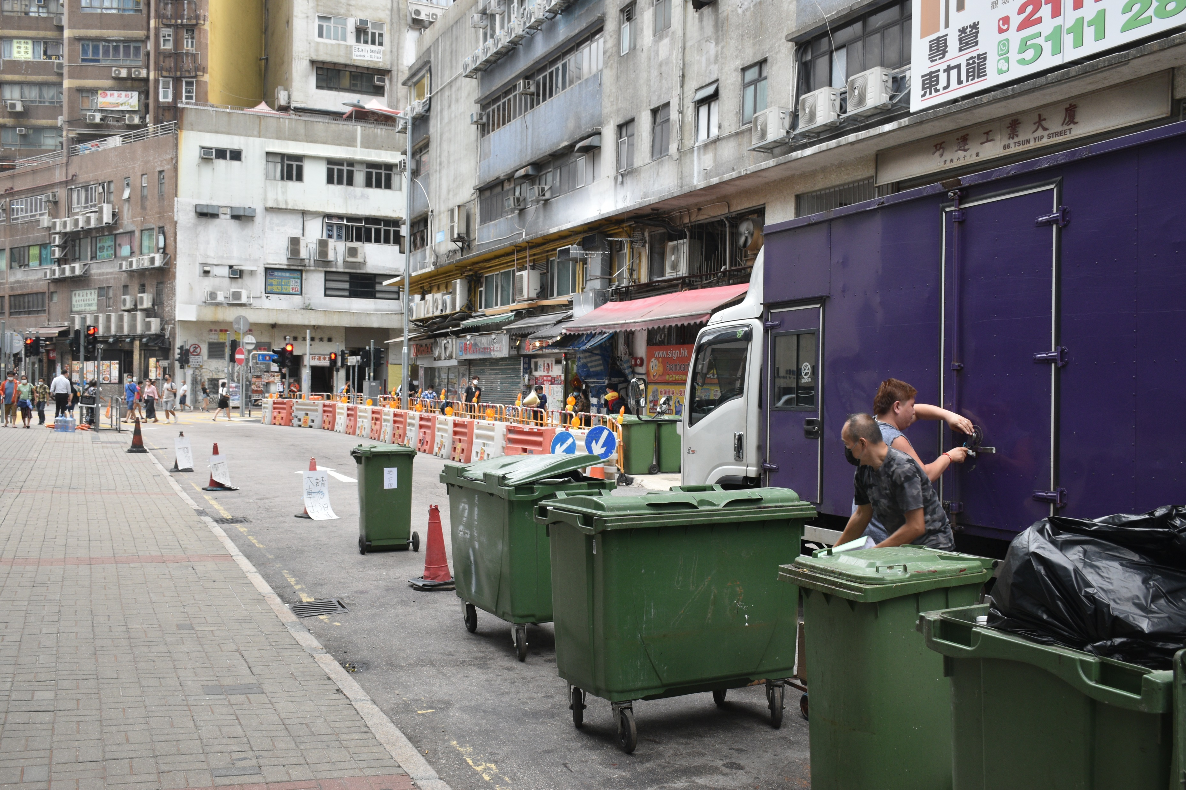
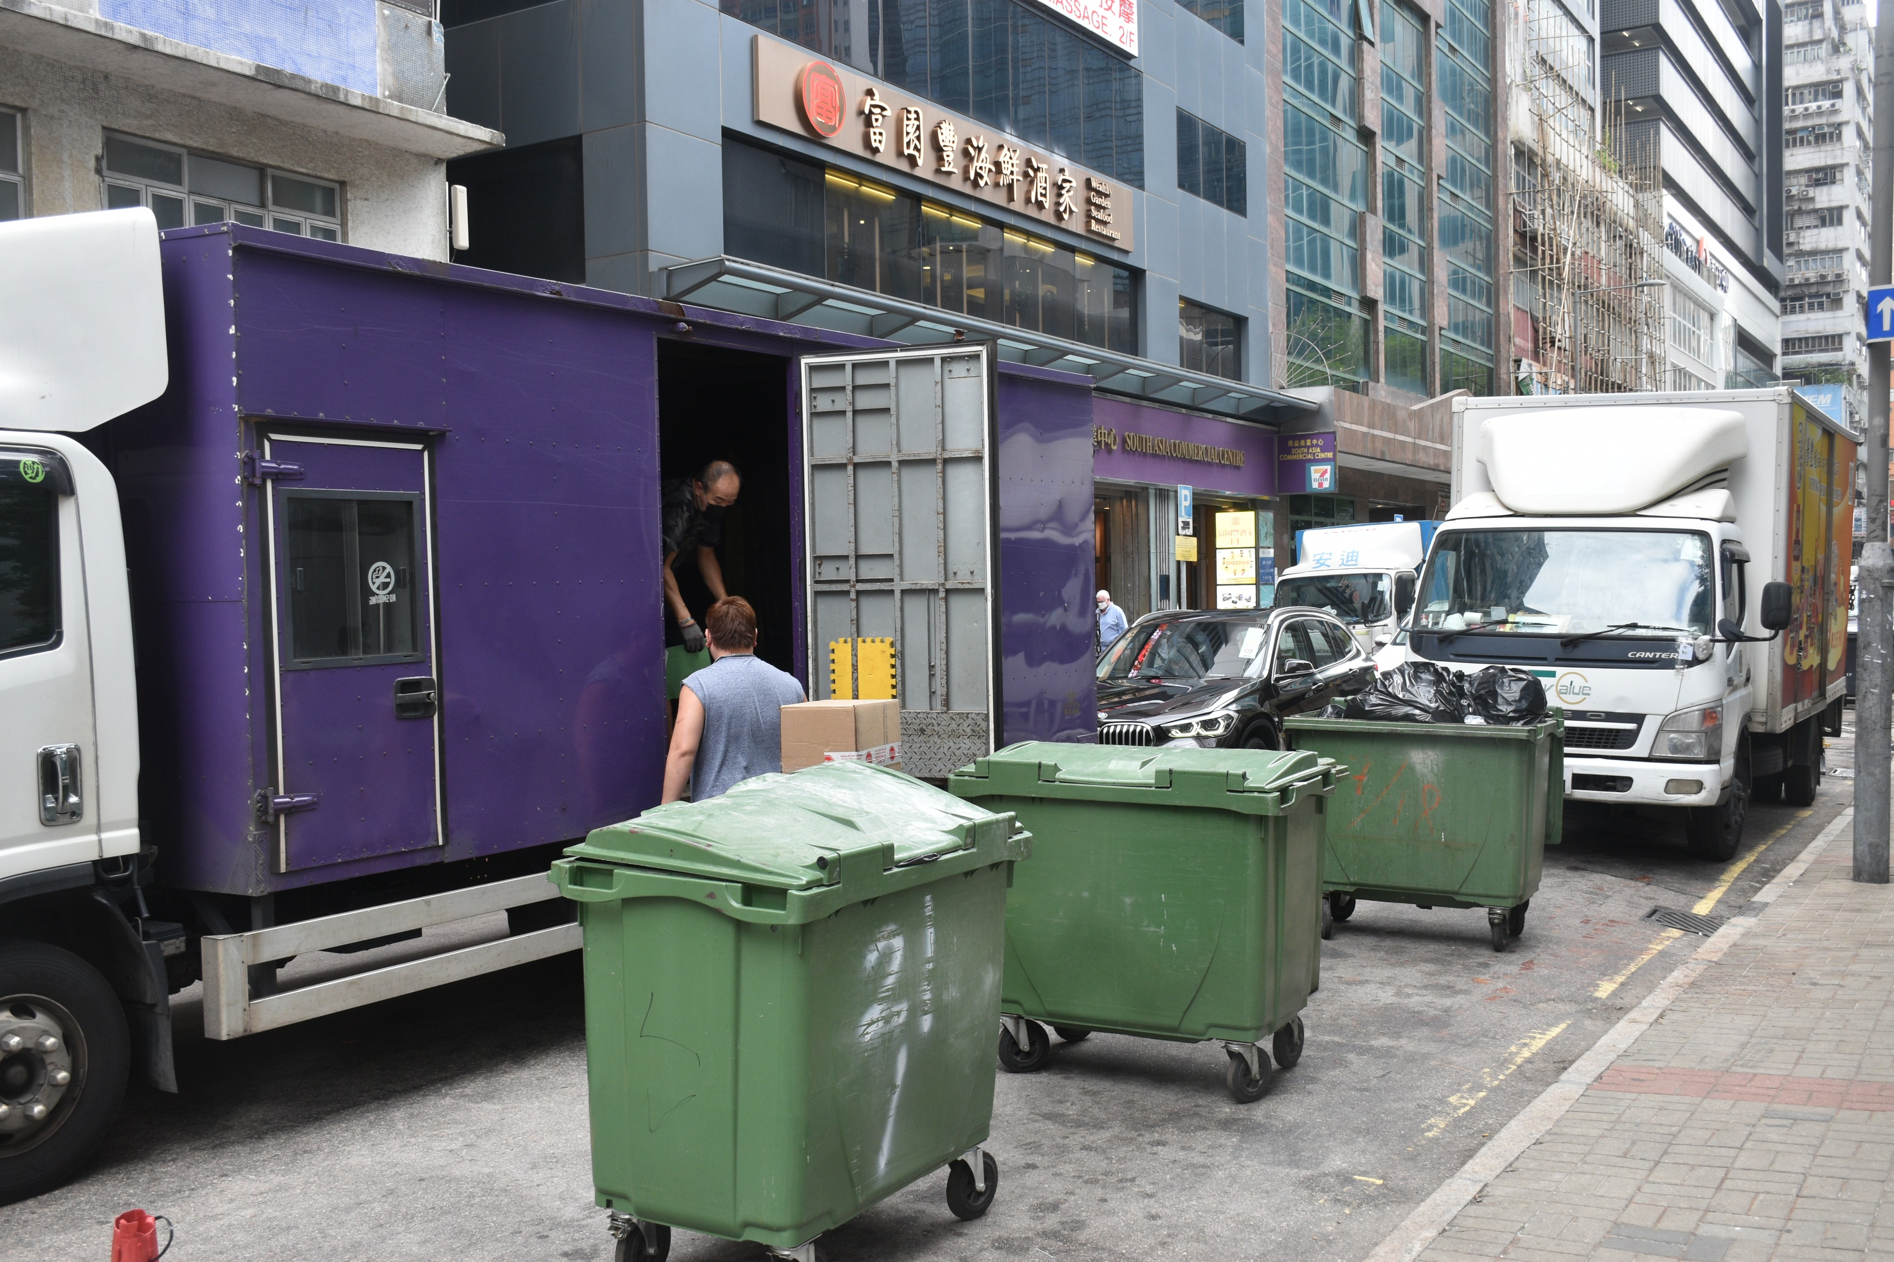
150m
N
Location
Generation of long traffic queue lags behind
Truck forced to unload goods at street centre
Road capacity significantly reduced
Disables opportunity for vehicles to park at supposed free space
Use of mobile barricades to reserve parking spaces
Notes:
PHSYICAL BARRICADES

Slide 41
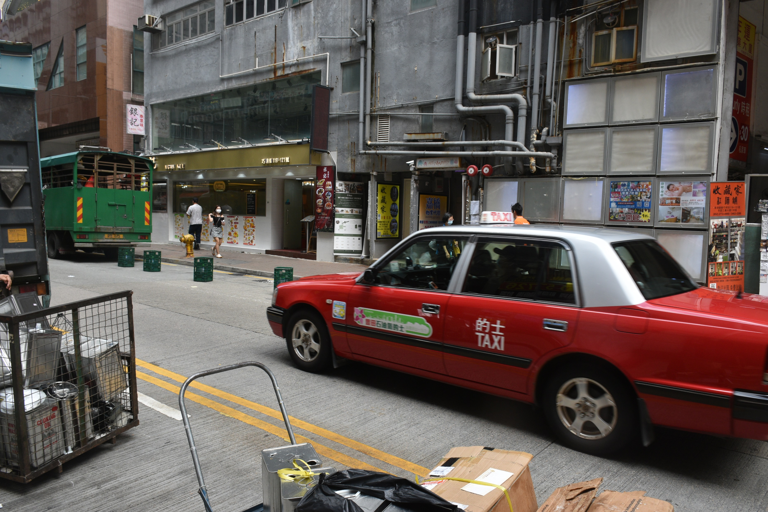
Vehicle acceleration may be sporadic when probing for parking spaces
Taxi cannot stop to wait for passengers
free parking space obstructed by barricades
Road capacity significantly reduced and becomes easily oversaturated
150m
N
Location
Notes:
PHSYICAL BARRICADES

Slide 42
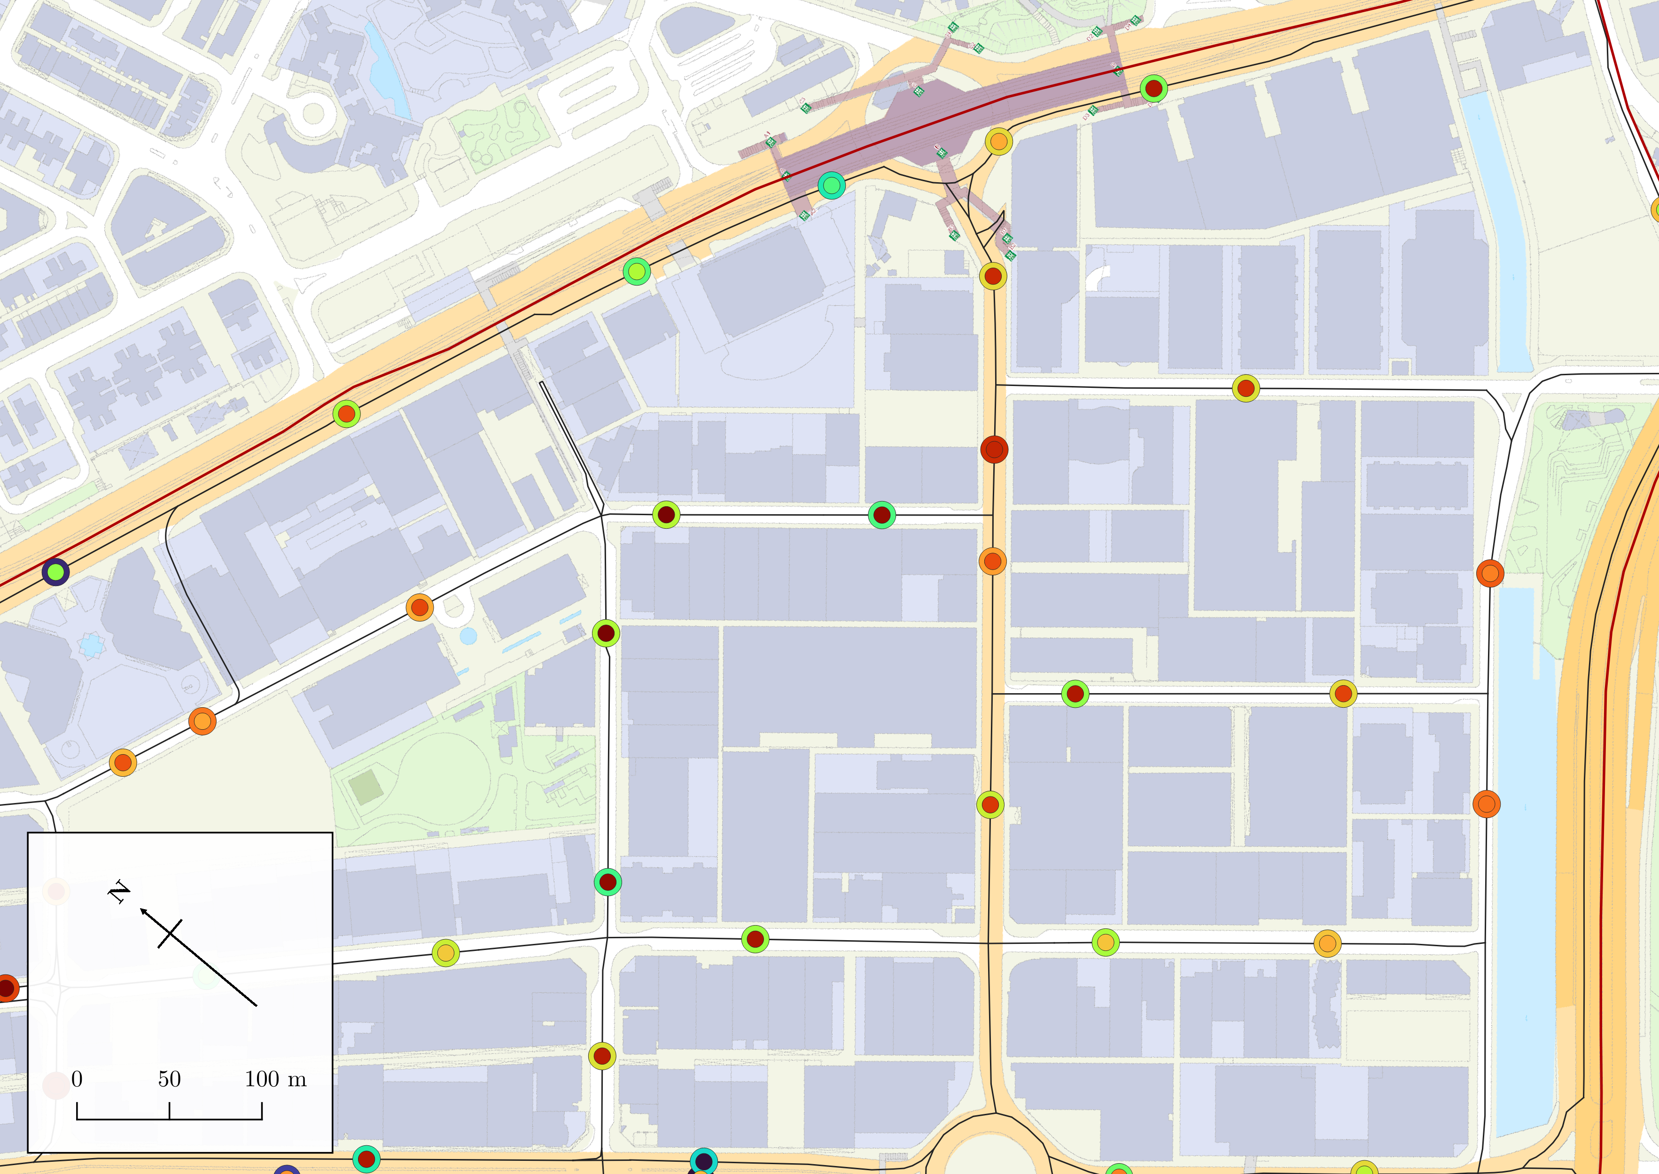
Legend
Study Area
Direction of traffic flow
KTR
Roads
*colour is indicative of traffic speed
Outer circle: parking accessibility
Inner circle: relative traffic speed
Colour denotes magnitude of variables
Parking accessibility
Relative traffic speed
Area 4
SYS
0
0.0736
270
10252
HMS
Area 3
KYS
HMS
HYR
HYS
TYS
Opportunity to linger in loop infinitely
HTR
WYS

Slide 43
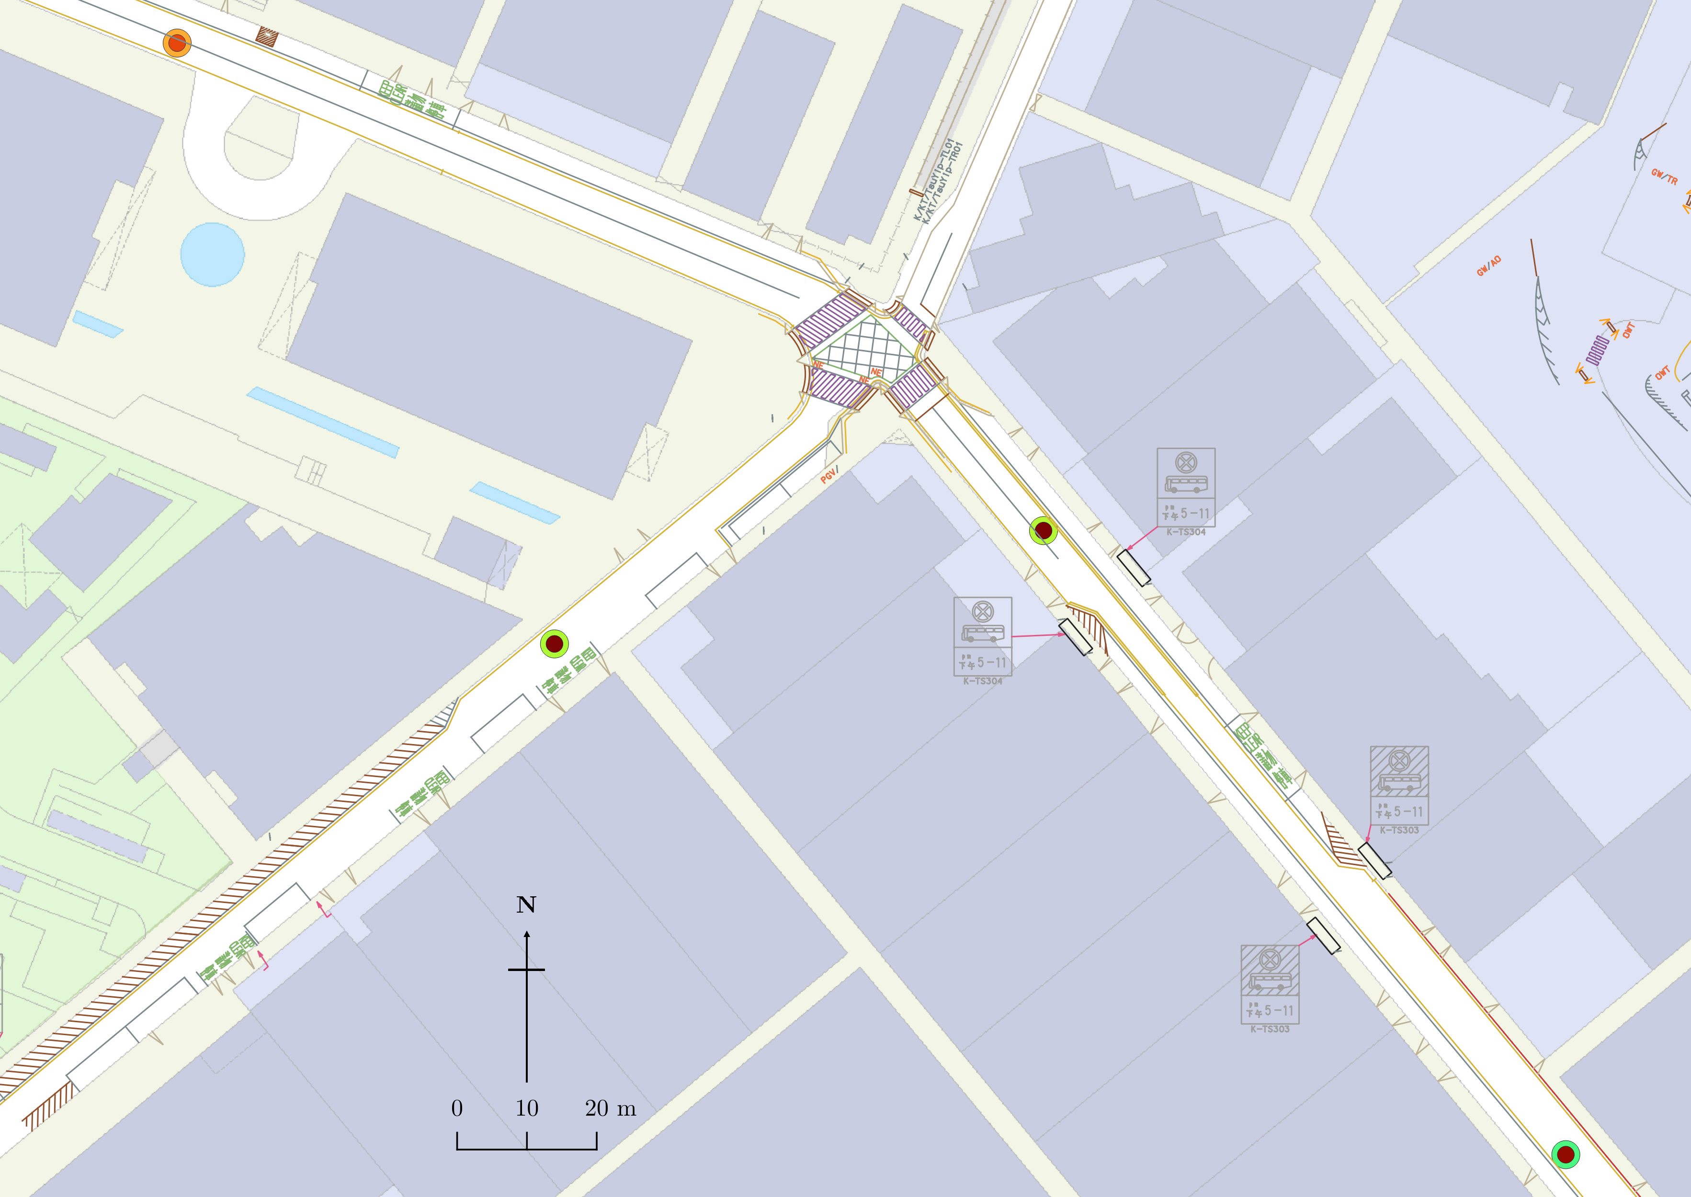
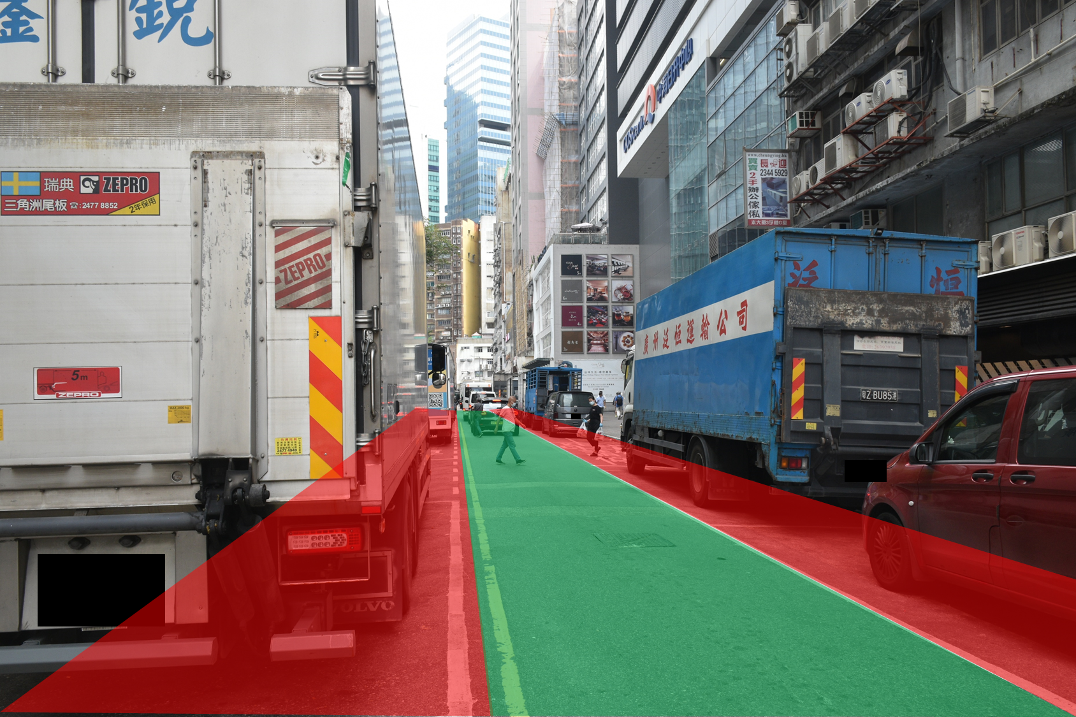
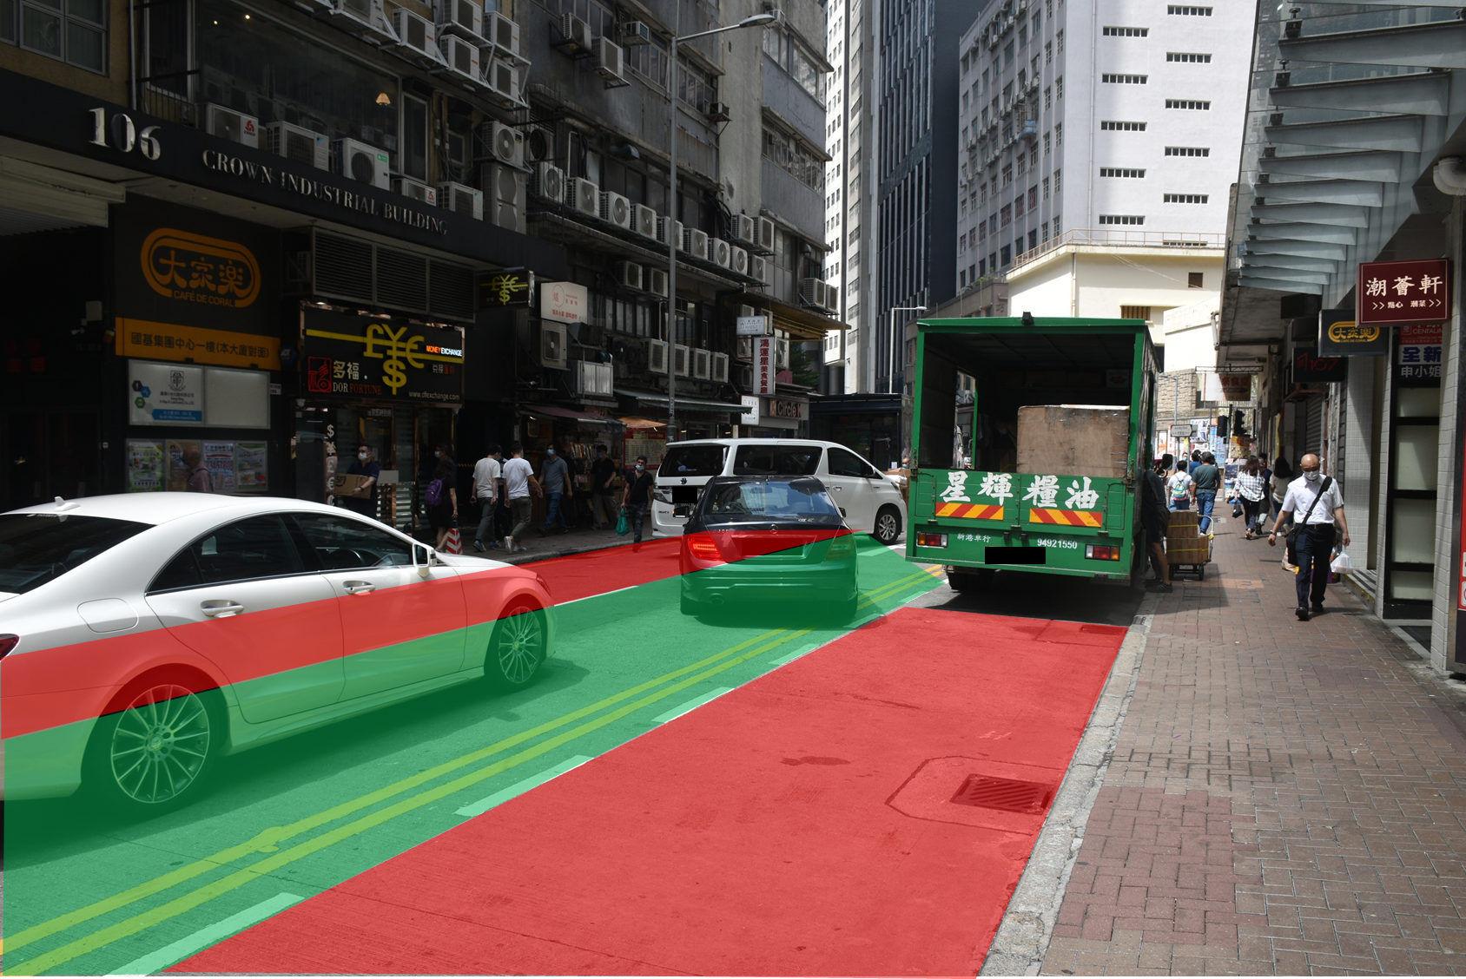
H
Legend
Traffic light at intersection
Traffic Lane Separator
Direction of traffic flow
HMS
*colour is indicative of traffic speed
Two effective lanes of traffic
Outer circle: parking accessibility
Inner circle: relative traffic speed
Colour denotes magnitude of variables
Parking accessibility
Relative traffic speed
0
0.0736
270
10252
Usable lane
Occupied lane
One effective lane of traffic
HMS
One effective lane of traffic
TYS

Slide 45
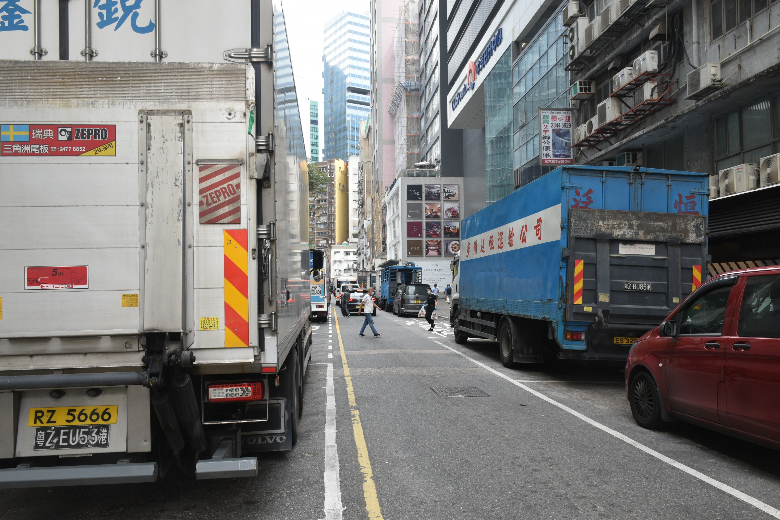

Slide 46
Case 1
Case 2
Underutilised lane of traffic
TYS
Green light
TYS
Red light
Key
Occupied lane
Usable lane
Underutilised lane
HMS
Red light
HMS
Green light
Unmoving lane

